Slide 1

SimpleMagic
Enhanced Video Advertising
Increasing Revenues Per Page View
December 2015

Slide 2

Challenged ?

Slide 3

Questions to consider
How do you monetize your mobile traffic?
How do you respond to high demand for video ads?
  And how do you do it on mobile?
What is your high impact offering?
How do you cope with viewability demands?
Do you have cross screen units?

Slide 4
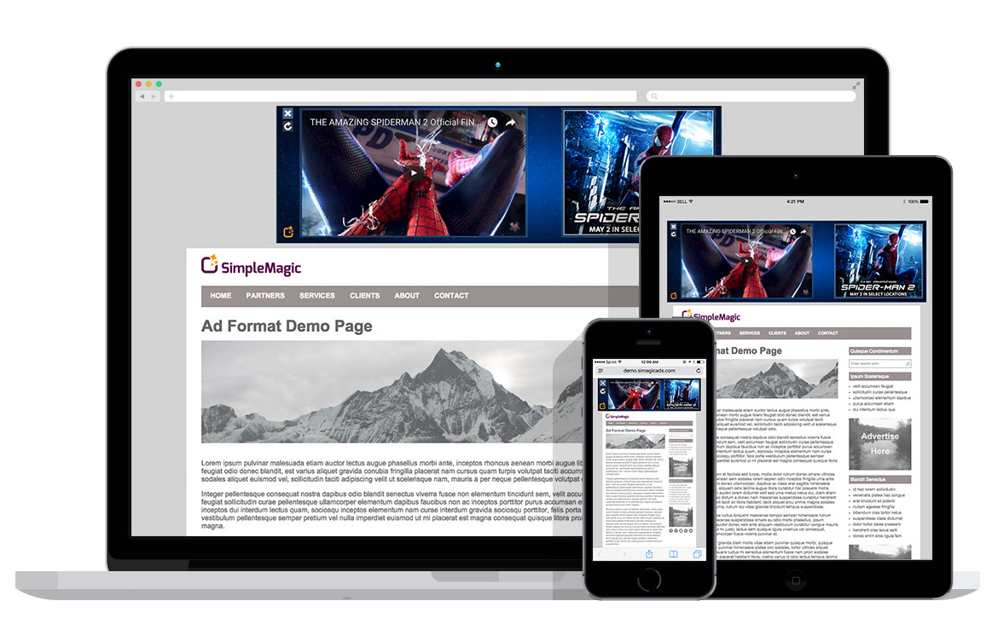
Introducing Simple Magic
Mobile First
Easy to use
Programmatic video and high impact advertising

Slide 5
Key Points
High quality video ads cross platforms (including iPhone)
Due to high demand command high CPMs
No creative work required
  Ads are created programmatically
Automatically stops when out of view
Polite (offer opt out, start with audio off, adjust video to bandwidth and more)
Can be sold direct or via programmatic channels

Slide 6








Gallery Page
Slider
Pushdown
Billboard
Video Pushdown
In Text
Branded Pushdown
Full Screen HF Video
Magnet (Mobile)

Slide 7


Key Benefits
  Video
  Compatible with all platforms
  Adjusts to screen size
  Adjusts to bandwidth
  Adjusts to device requirements
  Created automatically
  Agency provides vast tag
  Easy Reporting
  Standard reporting on agency systems
  High performance
  Viewable Only
  Social ready
  Polite
  offers opt out
  always start with audio off
Clear Close Option
Social Ready
Opt Out

Slide 8
How to start?
Review and sign contract
Deploy tech on site (like an SSP)
Accesses self served platform to sell directly
Connect to programmatic buyers to sell programmatically

Slide 9
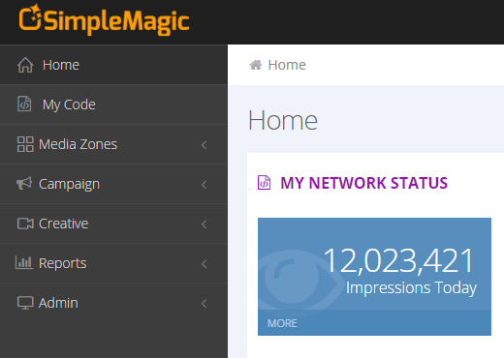
Platform Sections
Manage Permissions
Create IO Based Campaigns
Create ads from VAST
Campaigns Reports, Programmatic Demand performance etc

Slide 10

Thank you!
Raz Gold, Director of Biz Dev
Email: raz@simplemagic.com
www.simplemagic.com

