Slide 1

SimpleMagic
Enhanced Video Advertising
Corporate Presentation
July 2016

Slide 2

The Vision
Simple Magic offers enhanced video advertising solutions that benefit publishers, brands and consumers. Our vision is to simplify the creation and trade of more beautiful ads through automation

Slide 3
Key Points
Founded in 2014 by rich media and programmatic experts
Head quartered in New York, R&D in Tel Aviv, LATAM office in Miami
Self funded after successful previous exit
Core team cooperating for more than 10 years
Platform operational since October 2014
Based on proprietary cutting edge technology

Slide 4









Selected Partners

Slide 5


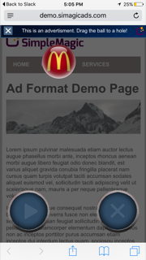
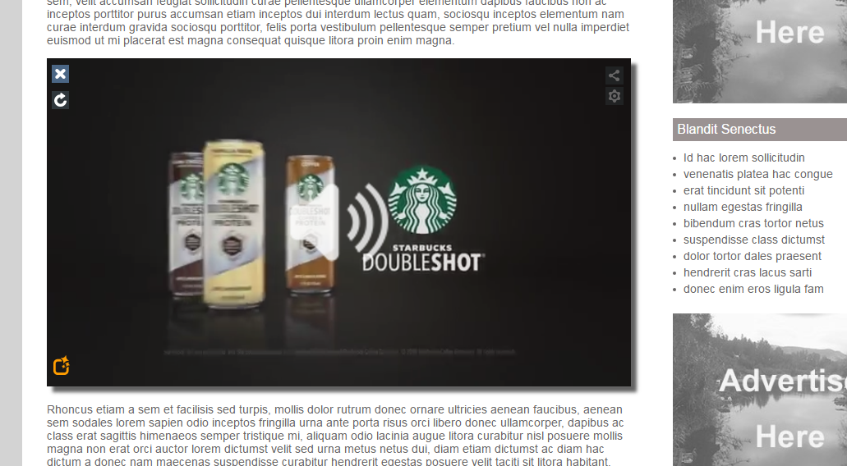

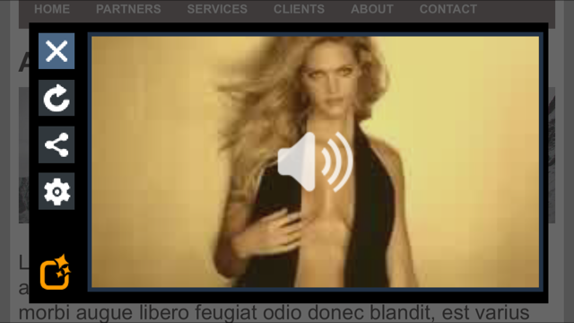
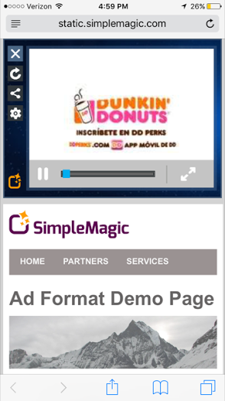


Selected Clients

Slide 6
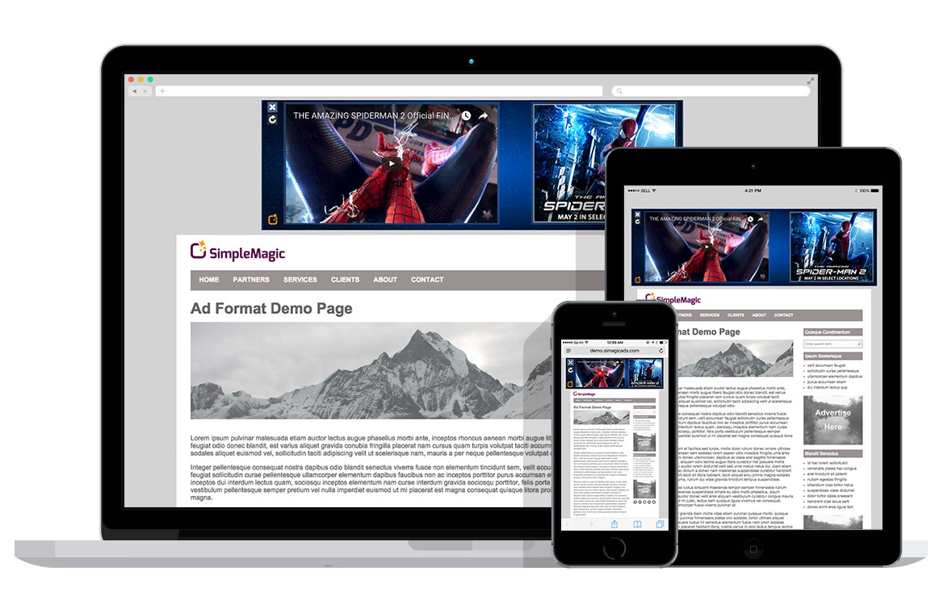
Introducing Simple Magic
Mobile First
Easy to use
Programmatic video and high impact advertising

Slide 7








Gallery Page
Slider
Pushdown
Billboard
Video Pushdown
In Text
Branded Pushdown
Full Screen HF Video
Magnet (Mobile)

Slide 8


Key Benefits
  Video
  Compatible with all platforms
  Adjusts to screen size
  Adjusts to bandwidth
  Adjusts to device requirements
  Created automatically
  Agency provides vast tag
  Easy Reporting
  Standard reporting on agency systems
  High performance
  Viewable Only
  Social ready
  Polite
  offers opt out
  always start with audio off
Clear Close Option
Social Ready
Opt Out

Slide 9
Resources
Available Units (Click Here to our Gallery page) - please note that all units are compatible with every screen, try them from the Gallery page on every device. Special focus is placed on activation on mobile devices and iPhone. Note that all units use viewable aware technology - they do not play if go out of view (on any device).
Top units:
Click here from any device for Header Video (wide)
Click here from any device for Header Video (Standard)
Videos:
Click here for why publishers like simple magic
Click here for video on why advertisers like simple magic.
Click here for publisher platform document
Click here for Buyer FAQ
Click here for about the technology

Slide 10

Thank you!
Raz Gold, Director of Biz Dev
Email: raz@simplemagic.com
www.simplemagic.com

