Slide 2
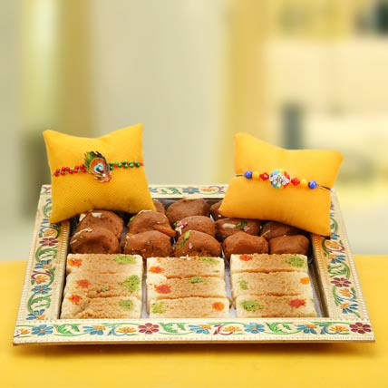
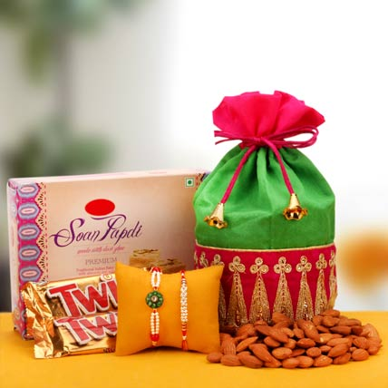
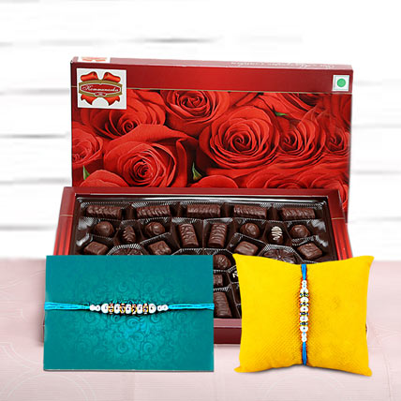
Rakhi with Sweets Online from Ferns N Petals
Rakhi is the best time to show your brothers and sisters the depth of your love. The bond that you share with your brother and sister is an eternal and undying one. You can get online rakhi with sweets once you login to our beautiful website.

Slide 3
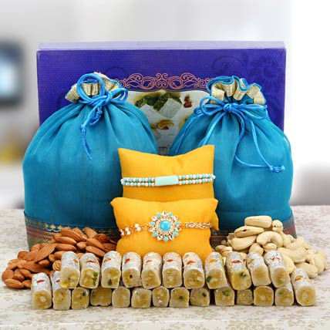
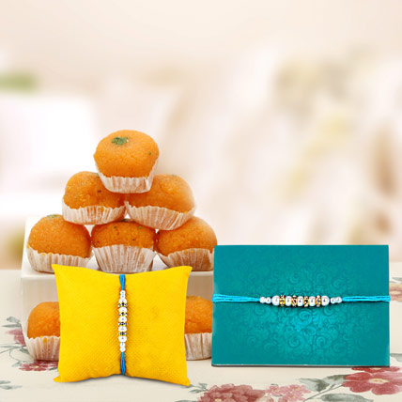
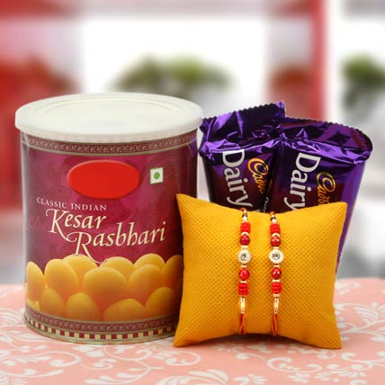
Sweets form a necessary element in our celebrations because of the obvious reason that it increases the sweetness of our relationships. Sweets for rakhi is therefore the most important ingredient that you would require. The stock of our sweets is vast. So, splurge on mesmerizing Kaju Katli, Kaju Barfi, Roshogolla, Gulab Jamun, Laddoo, Petha, etc.

Slide 4
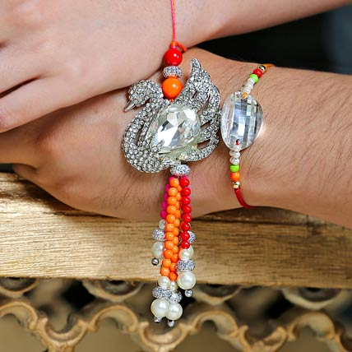
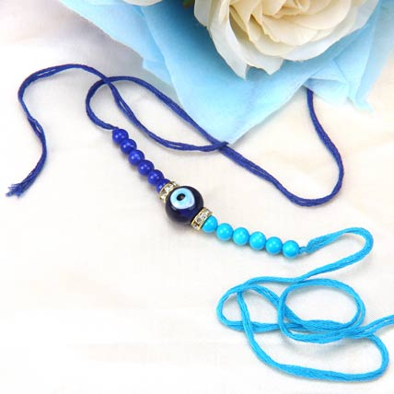
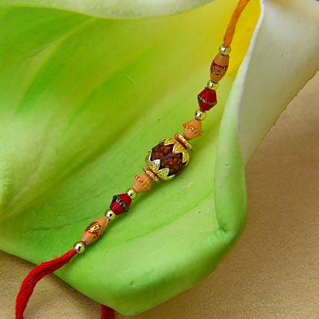
For all your brothers and cousins get the attractive rakhi sets online and surprise them. The immense variety of rakhis we have are – simple threaded ones, American diamond rakhis, lumba rakhi, feng shui rakhi, mauli rakhi, etc.

Slide 5
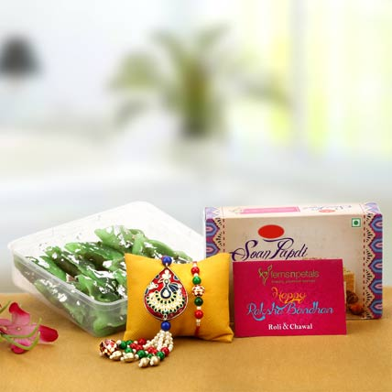
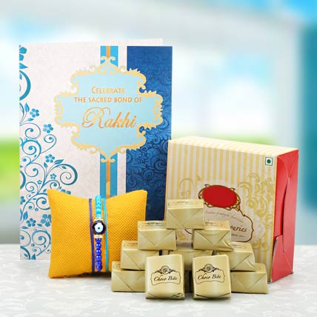
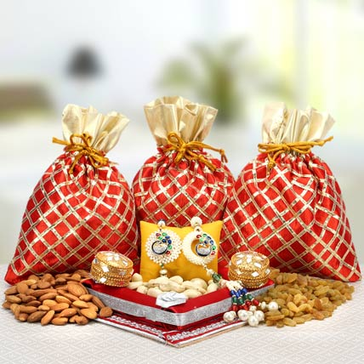
We at Ferns N Petals have been in this gifting world for more than two decades and hence we know the pulse of our customers more than anyone else. Our wide network of services have covered considerable parts of India and is in the process of expanding all across the globe.

Slide 6
Visit Us At
Address
Contact Us
Ferns N Petals Pvt. Ltd.
FNP Estate, Ashram Marg
Gadaipur, Mandi Road
New Delhi, INDIA
Tel: 011 - 2680 2680
http://www.fnp.com/
Email-id: support@fnp.com

