Slide 2
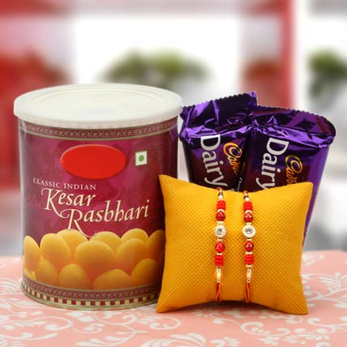
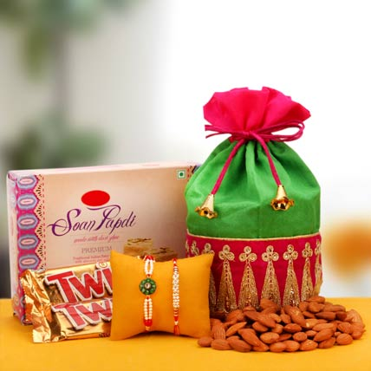
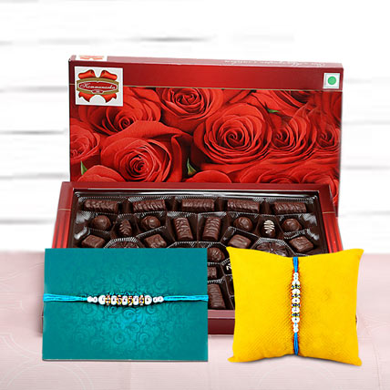
Rakhi Gifts for Kids in India Online – Ferns N Petals
Kids are a little hard to please and you have to look for something really nice on the occasion of Rakshabandhan.

Slide 3
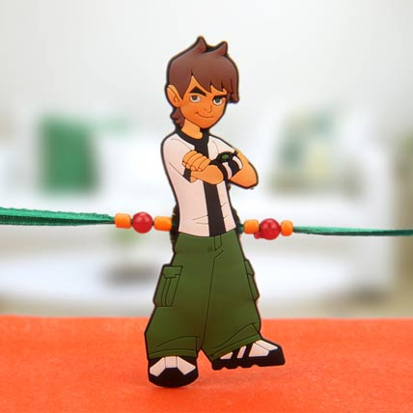
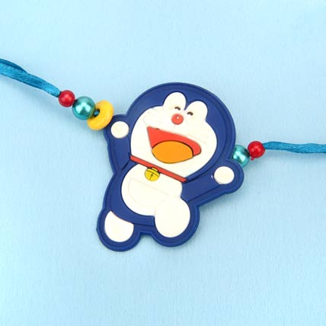
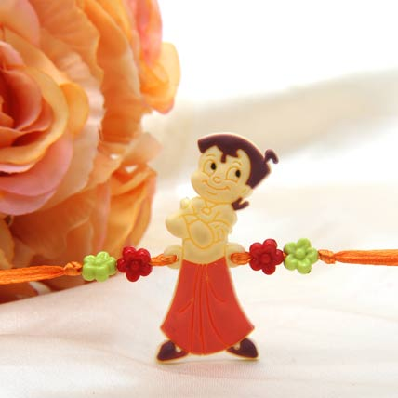
How about treating your brother with something cute and adorable, Ferns N Petals have come up with an amazing collection of rakhis and rakhi gifts for kids to make their festive season lovely. You can shop for chocolate hampers and gift baskets which will make the occasion memorable. The online portal has come up with special rakhis such as Doraemon rakhi, Chhota Bheem and Chutki rakhi, Captain America and other cartoon rakhi which are quite popular amongst most kids.

Slide 4
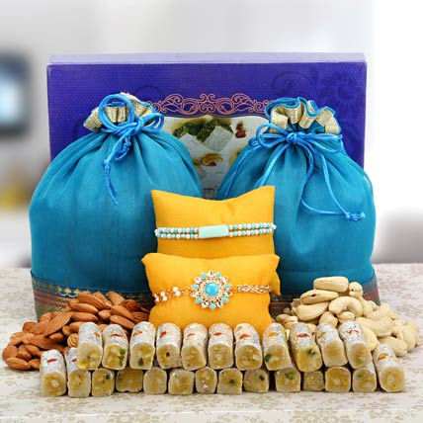
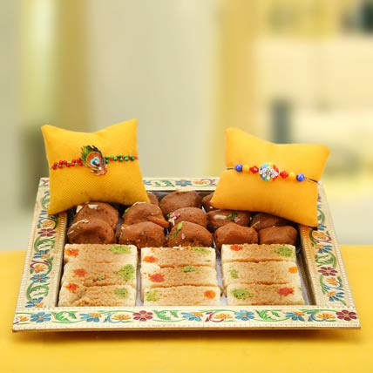
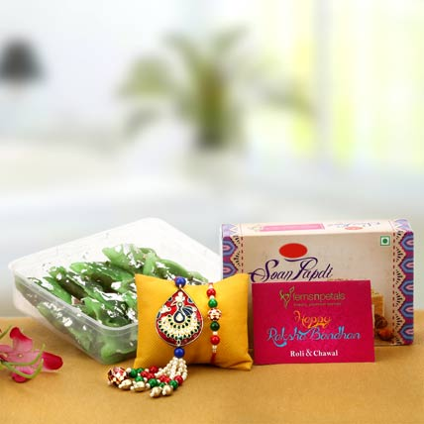
Complement these rakhis with his favourite sweets such as Motichoor Laddoos, Kaju Katli, Petha, Peda and other relishing sweets for the occasion. Sweets turn out to be the best rakhi gifts for brother as it turns out to be one of the most relishing gifts for the occasion.

Slide 5
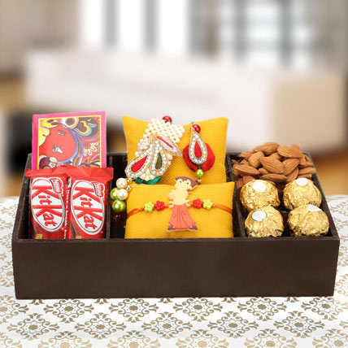
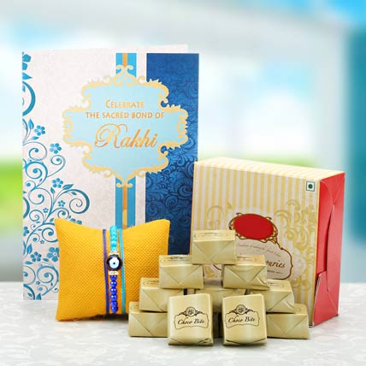
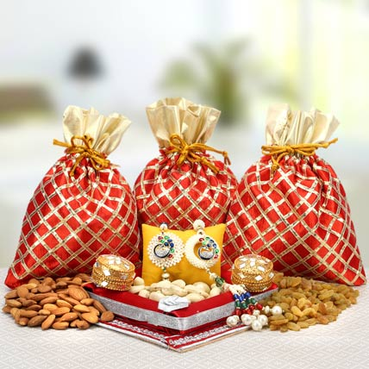
Delivery is a major problem during the festive season. Therefore, we have made the delivery services both simple and easy. You can get rakhi delivery in India and abroad with flexible delivery options, you can get both same day and next day delivery options .

Slide 6
Visit Us At
Address
Contact Us
Ferns N Petals Pvt. Ltd.
FNP Estate, Ashram Marg
Gadaipur, Mandi Road
New Delhi, INDIA
Tel: 011 - 2680 2680
http://www.fnp.com/
Email-id: support@fnp.com

