Slide 1


Playa del Carmen Mexico
www.acantohotels.com
984-873-1252

Slide 2
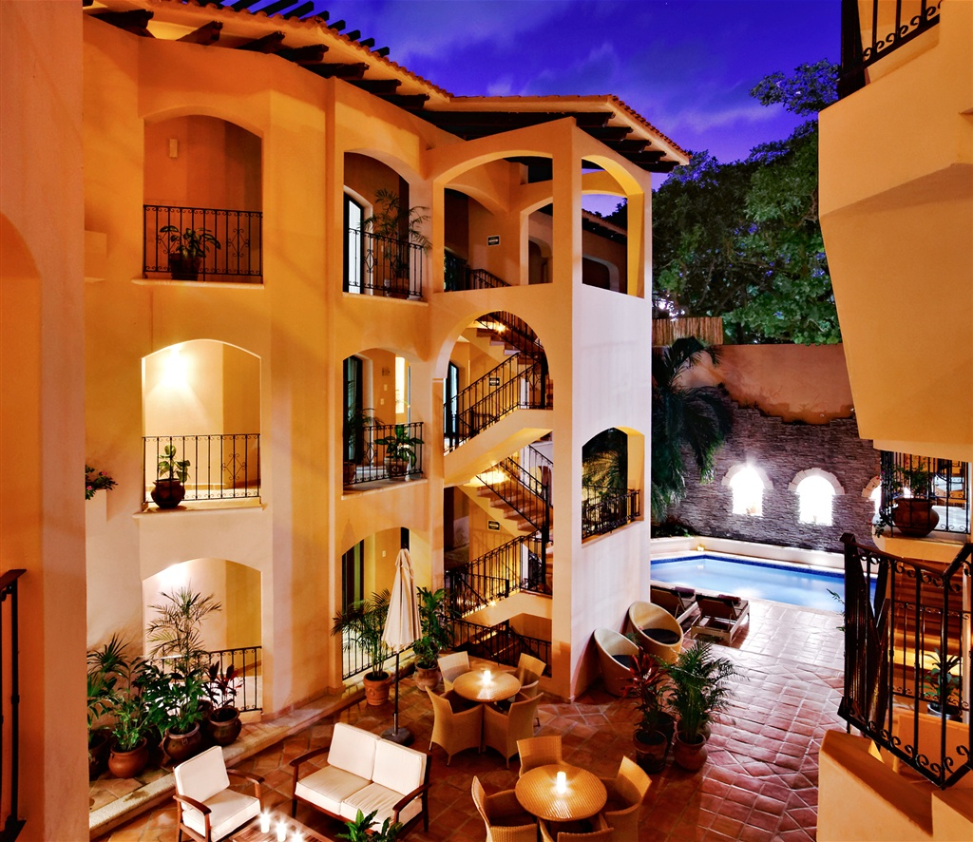
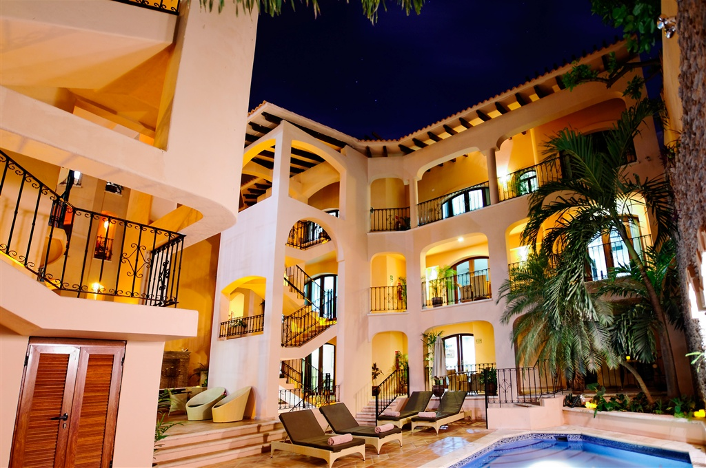
Nuestras Instalaciones/ Our Property

Slide 3
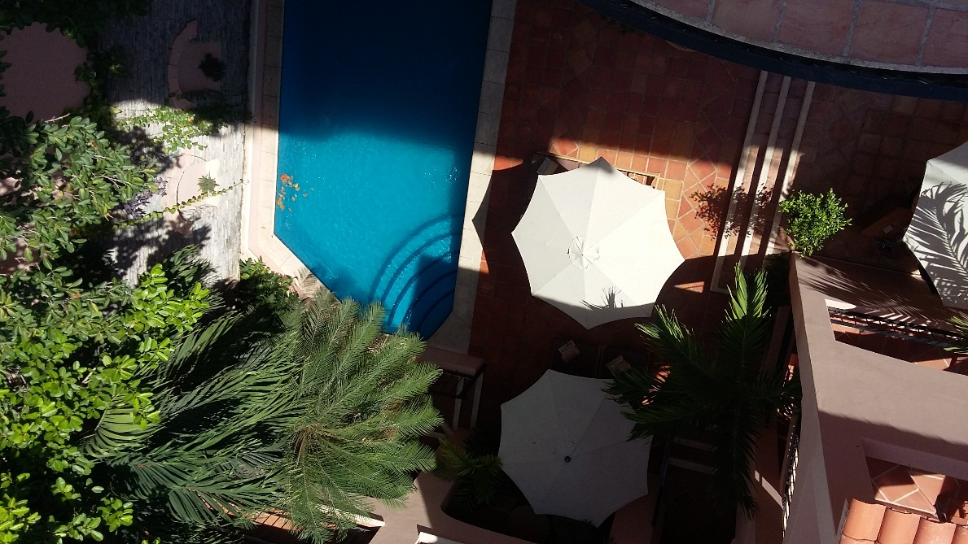
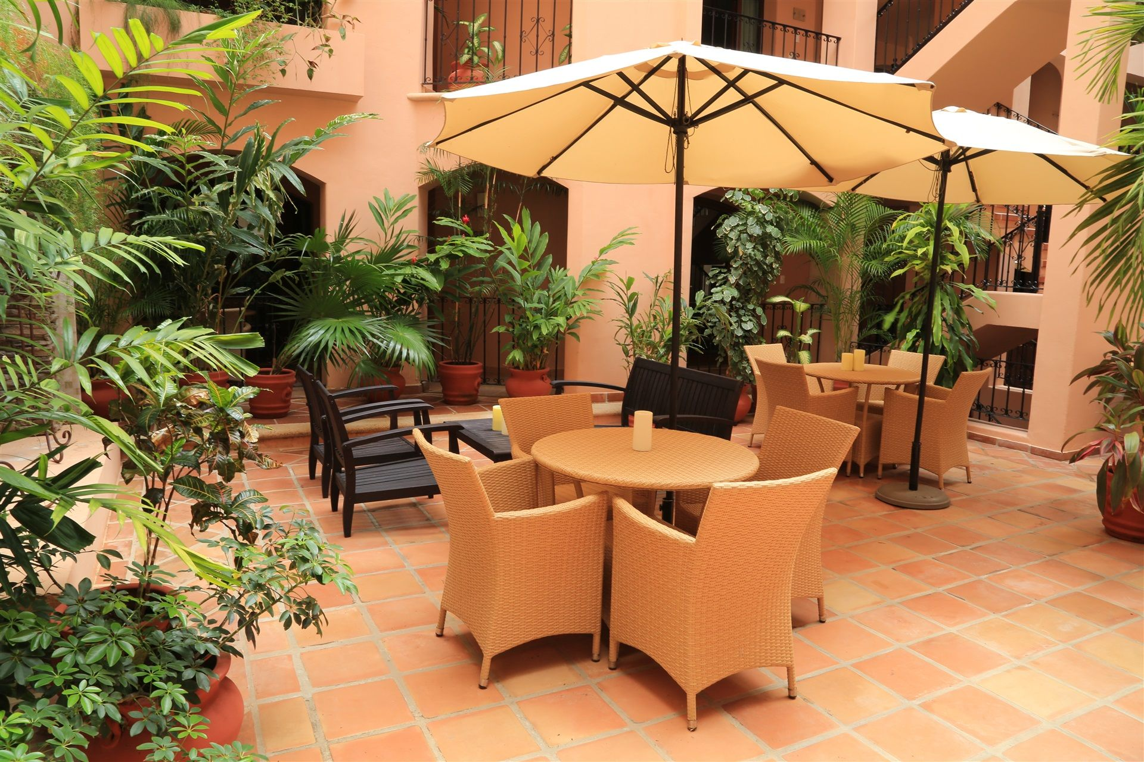
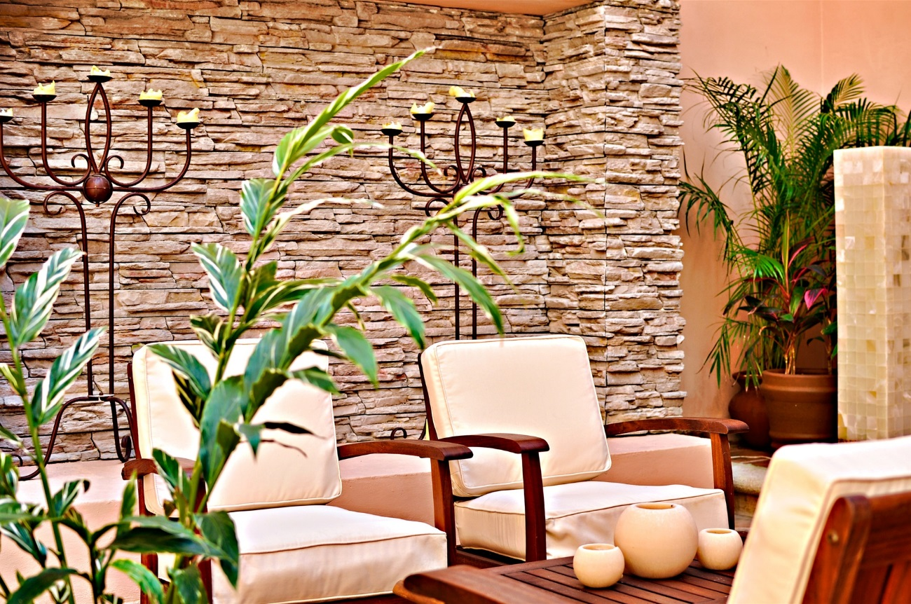
Common Area/ Area comun

Slide 4
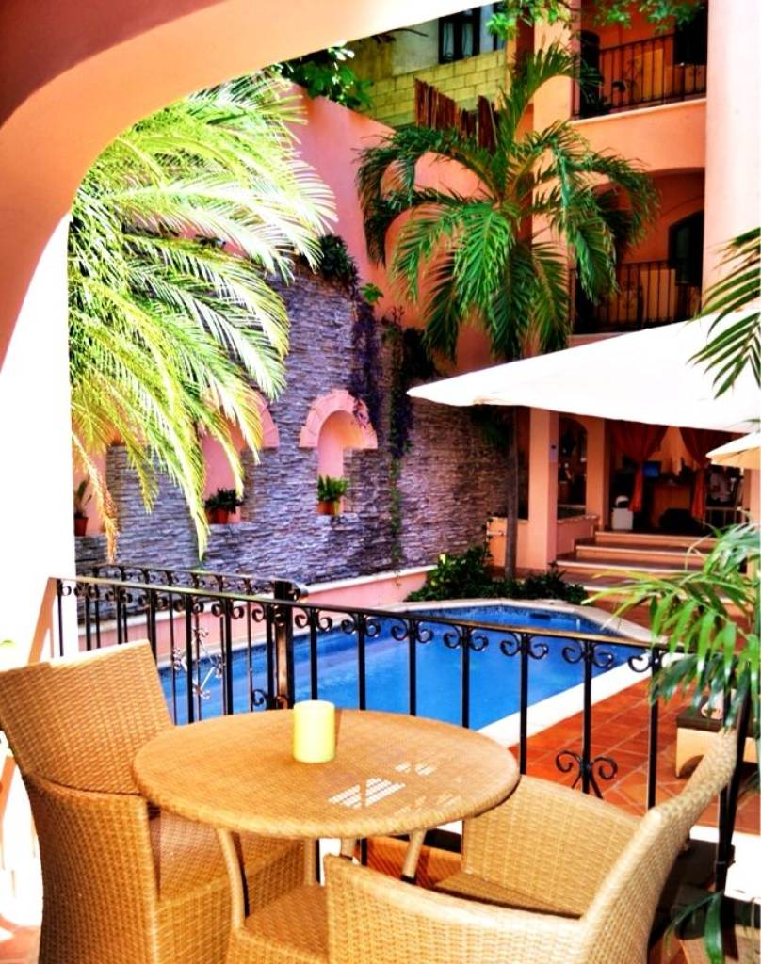
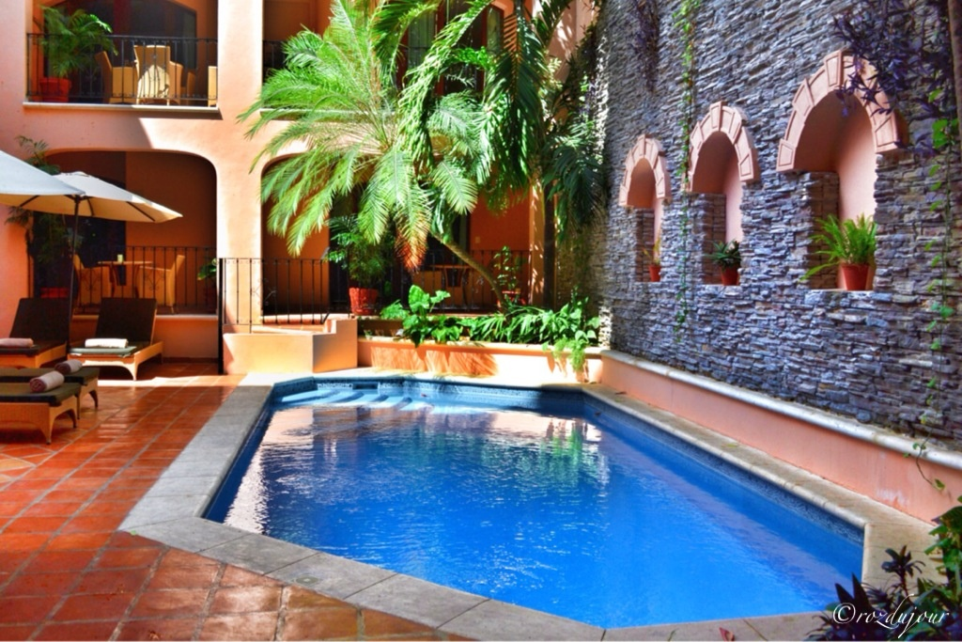
Alberca/ Pool

Slide 5
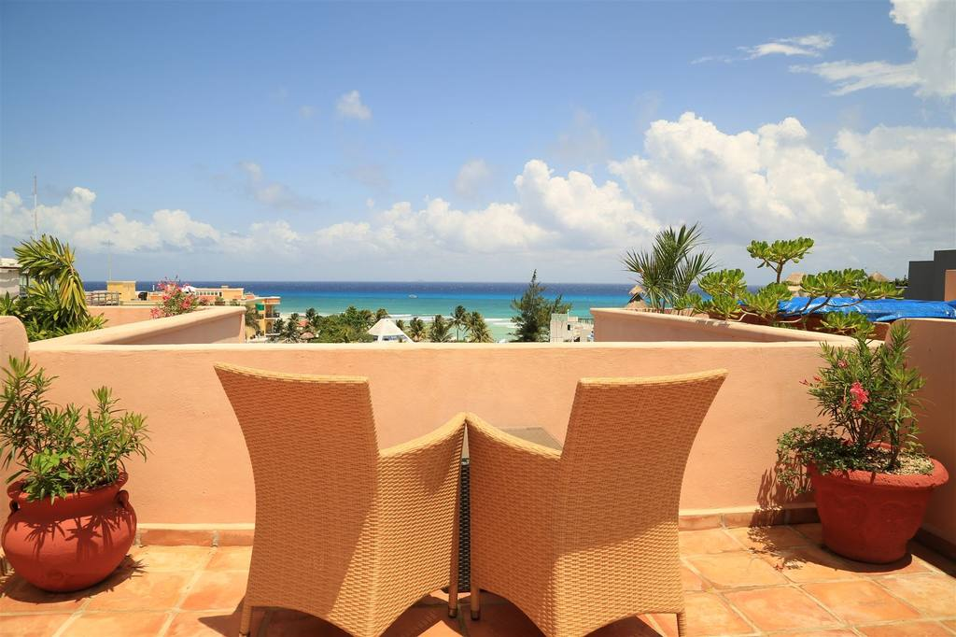
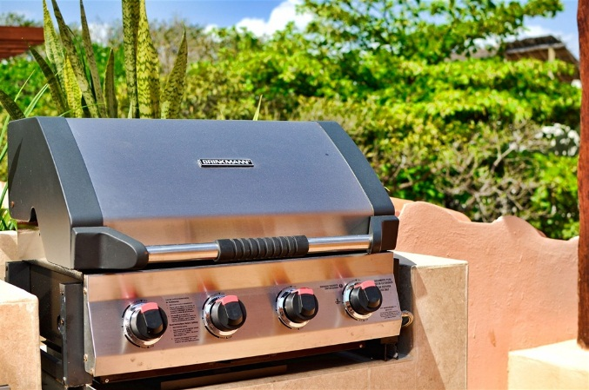
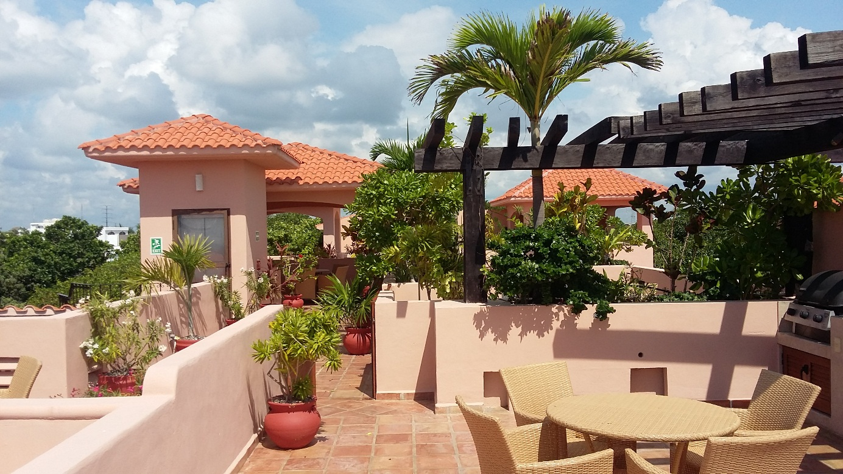
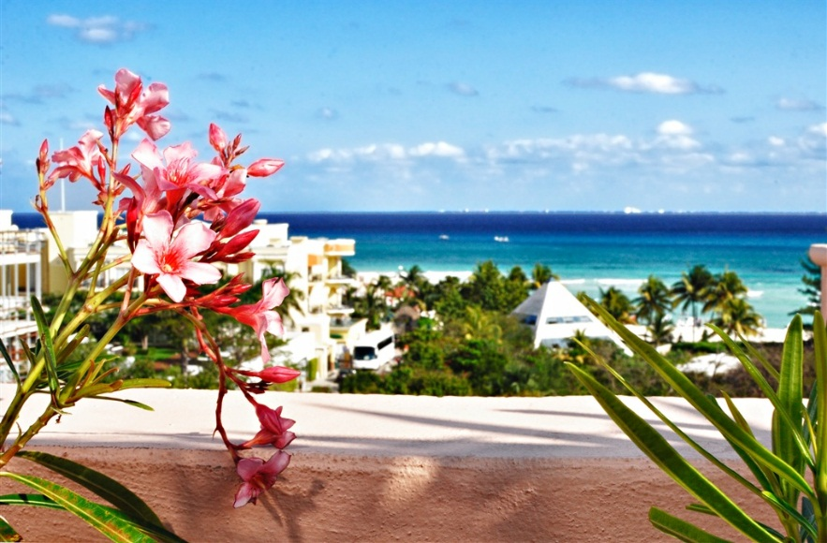
Azotea/ Rooftop

Slide 6
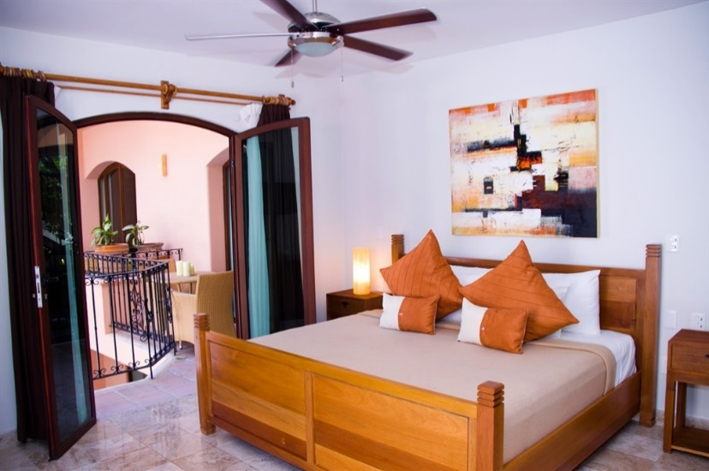
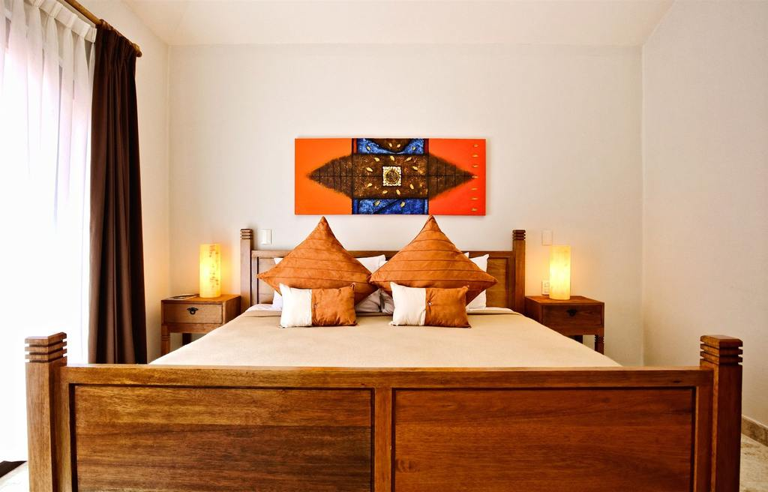
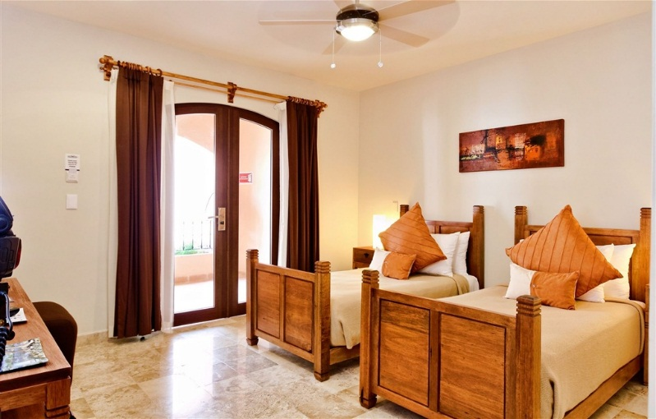
Nuestras habitaciones/ Our bedrooms

Slide 7
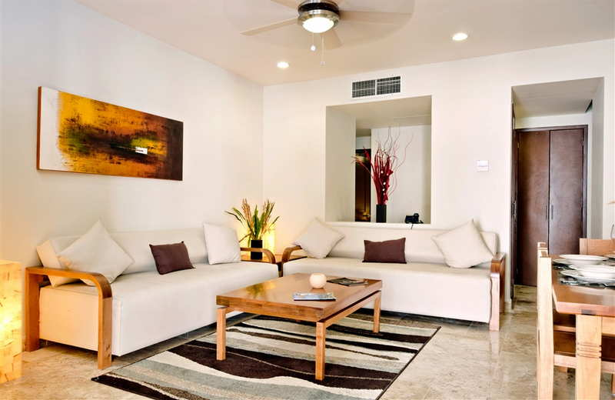
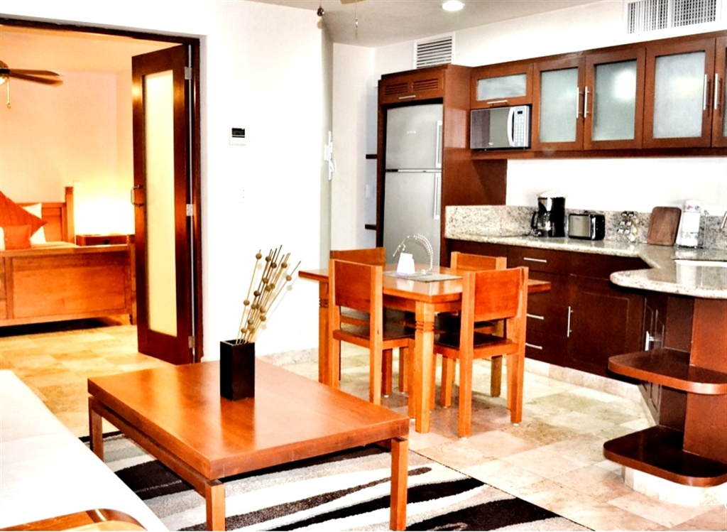
Sala-comedor/ Living-Dining room

Slide 8
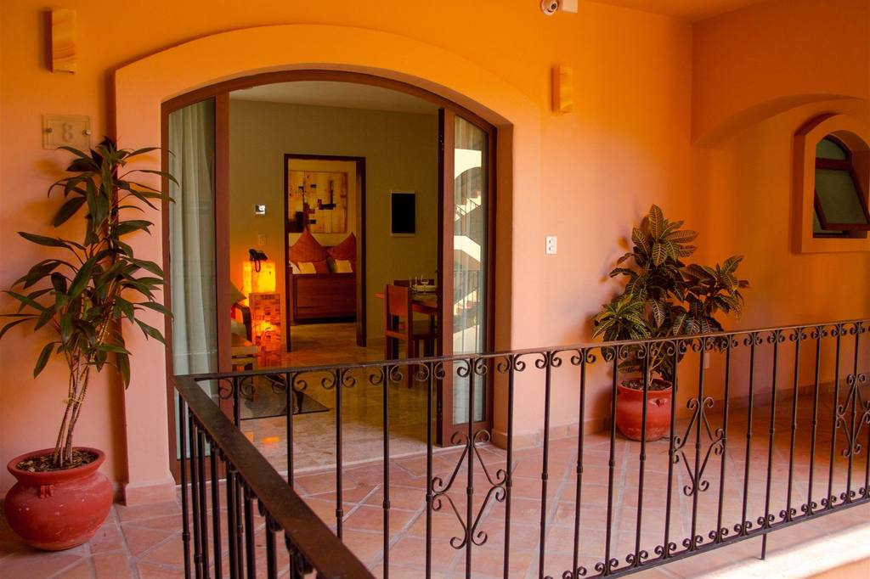
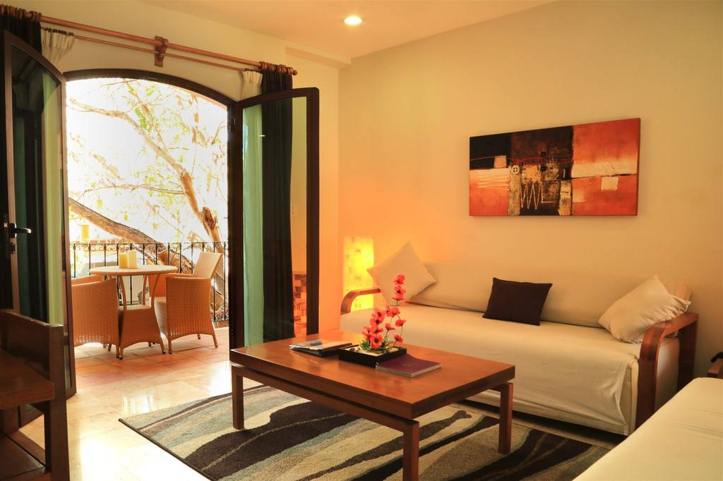
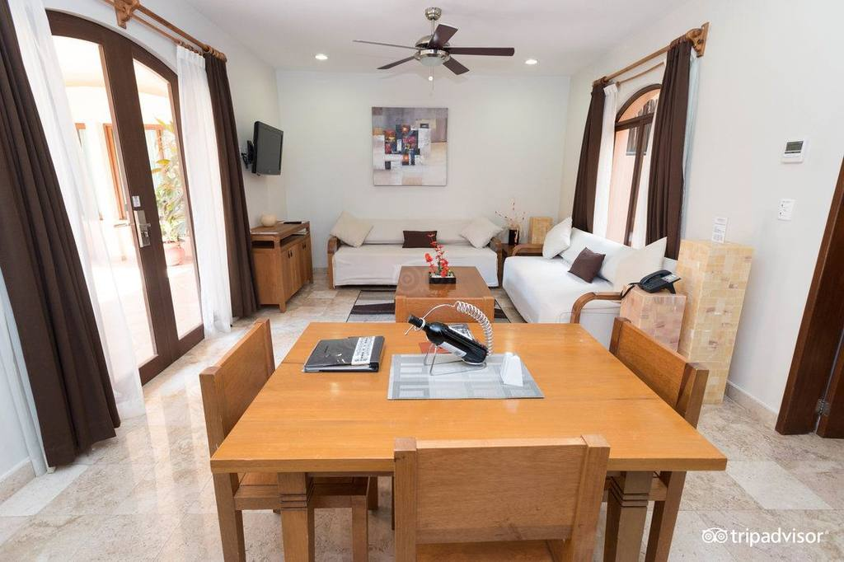
Espacioso/ Spacious

Slide 9
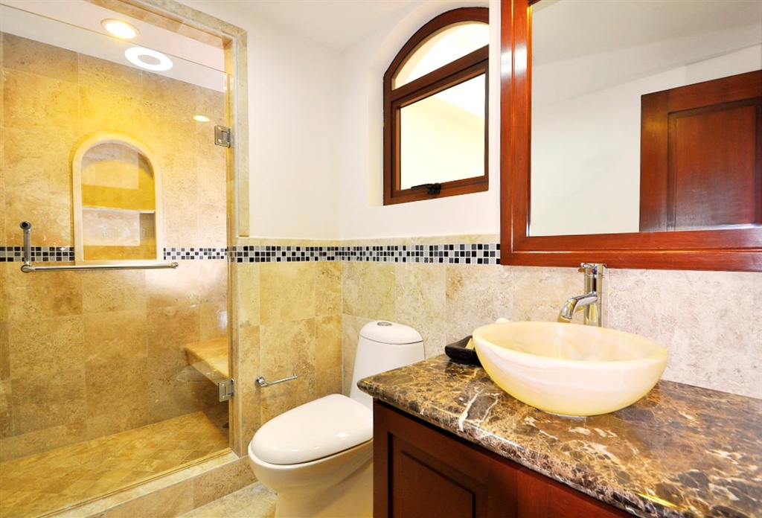
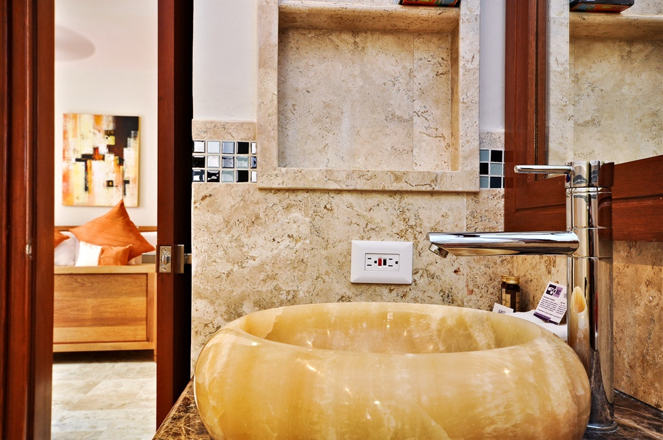
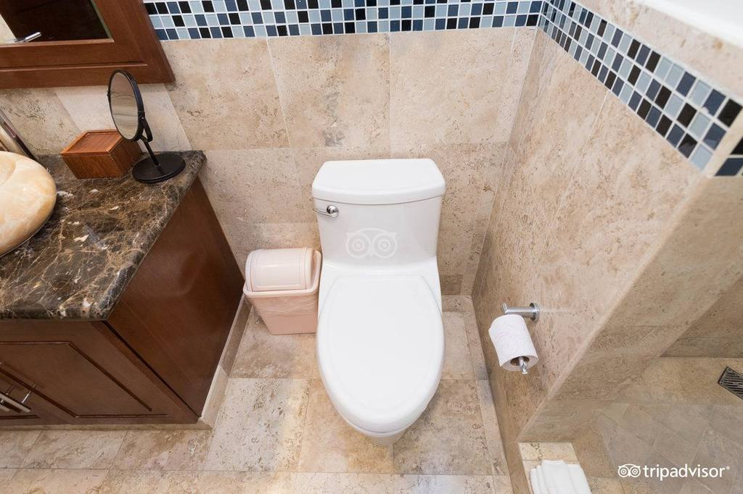
Baños de mármol/ Marble Bathrooms

Slide 10
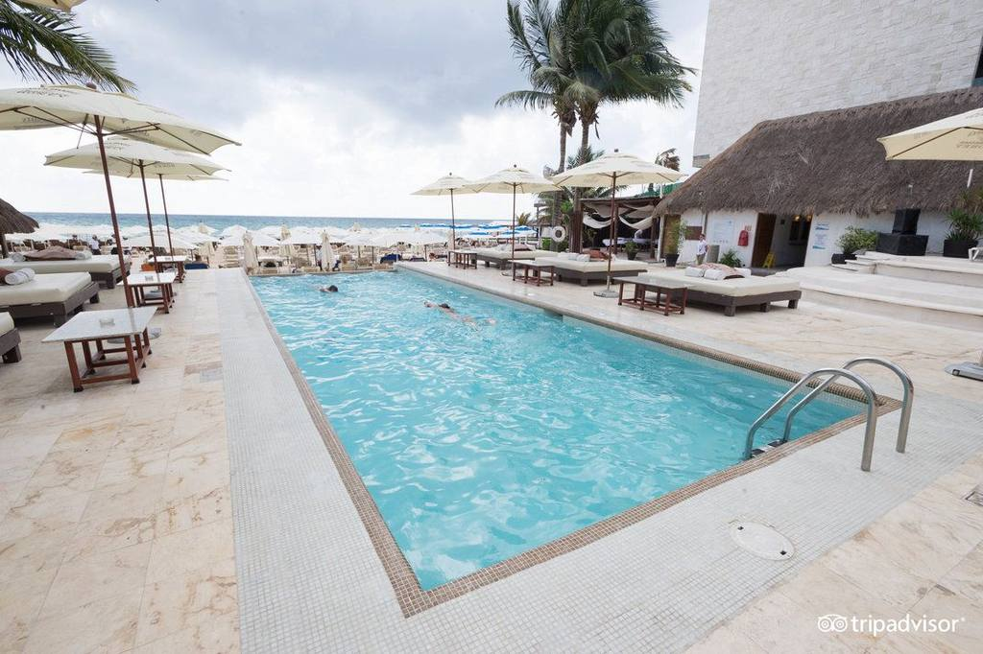
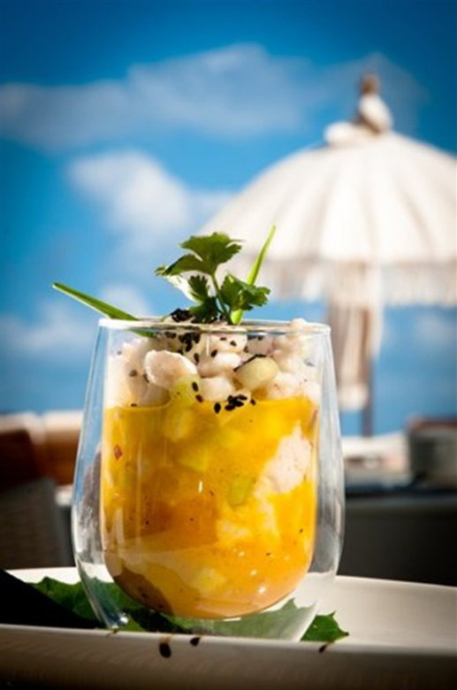
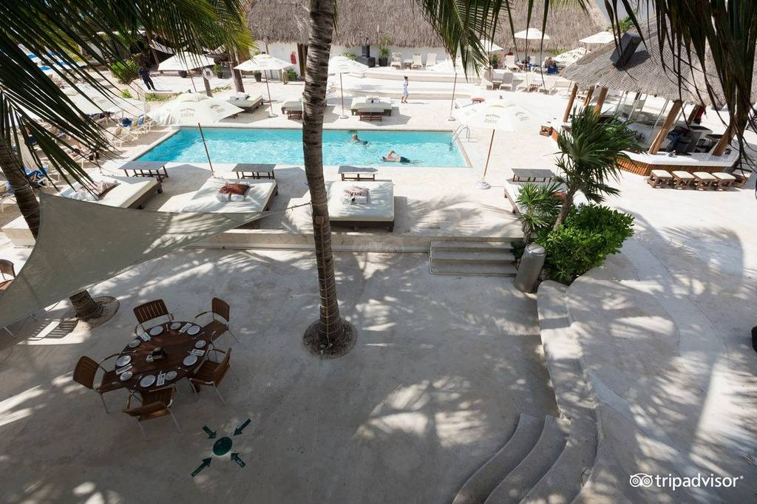
Beach Club access
Acceso a club de playa

Slide 11
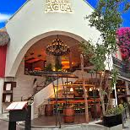
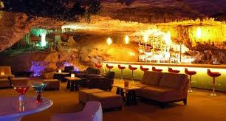
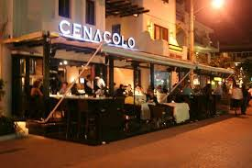
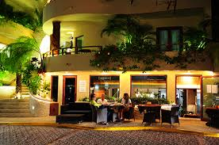
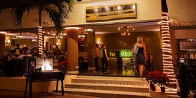
Restaurants/ Restaurantes

Slide 12
The Acanto Hotel and Suites is Tripadvisor's top choice for an all suite Boutique Hotel in Playa del Carmen. Acanto is just steps to the beach and in the center of town. The Hotel offers, luxurious, 1,2 and 3 bedroom private and chic accommodations. All of our guests enjoy daily complimentary continental breakfast, wifi, phone calls, discounts to local area restaurants, beach clubs & spa. Acanto is also known for its VIP guest services that are unmatched in the hotel industry.
Contact us at 984-873-1252 or 984-147-3072
frontdesk@acantohotels.com
www.acantohotels.com

