Slide 1

How to make a favorite theme for yourself by using 3D PageFlip Professional?
3DPageFlip

Slide 2
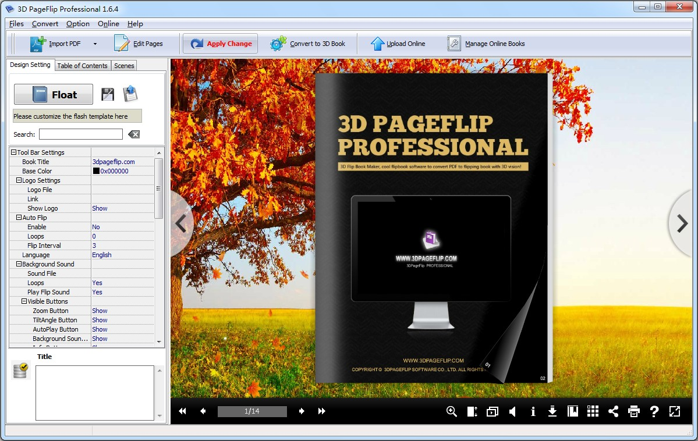
3D Page Flip Professional
All-in-one flip book maker, an affordable tool to convert PDF, OpenOffice, Images to realistic flipping book with rich multimedia elements embedded in pages!

Slide 3
How to make a favorite theme for yourself?
3D Page Flip Professional is a professional and humanizing software, so you can make a DIY theme for yourself effortlessly. It does not require any professional skills and instructions.
1
Select favorite template
2
Insert background image
3
Template design settings

Slide 4
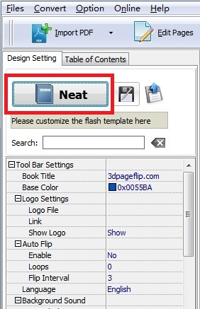
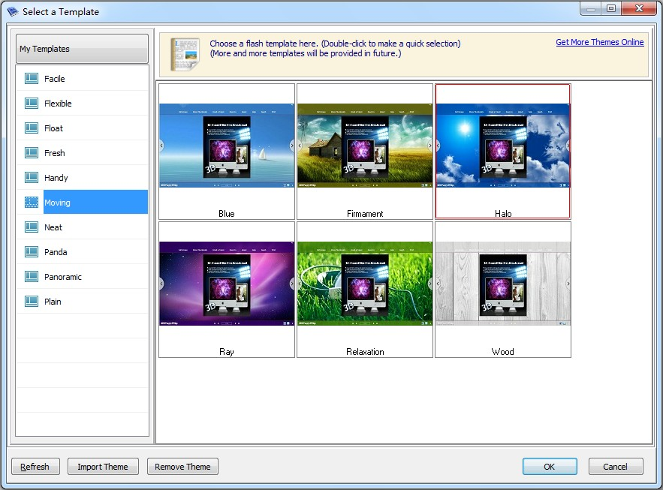
Step 1: select favorite template
First of all, just launch 3D PageFlip Professional and then select your favorite template in the design setting.

Slide 5
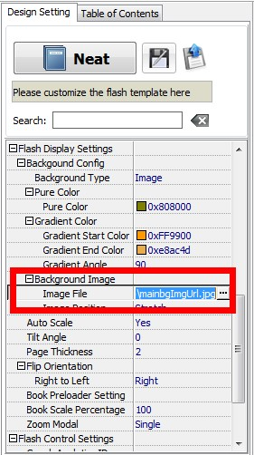
Step 2: Insert background image
Second, you need to import an image by clicking the “Image File”. After you insert an image, you can adjust the background position as well. You need to click the icon of “Apply Change” to finish the setting.

Slide 6
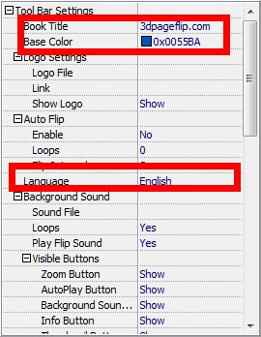
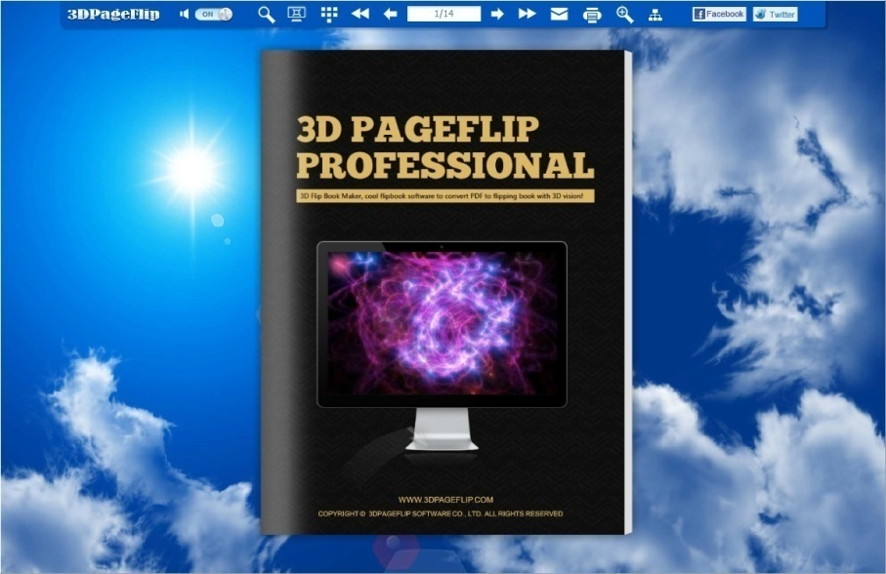
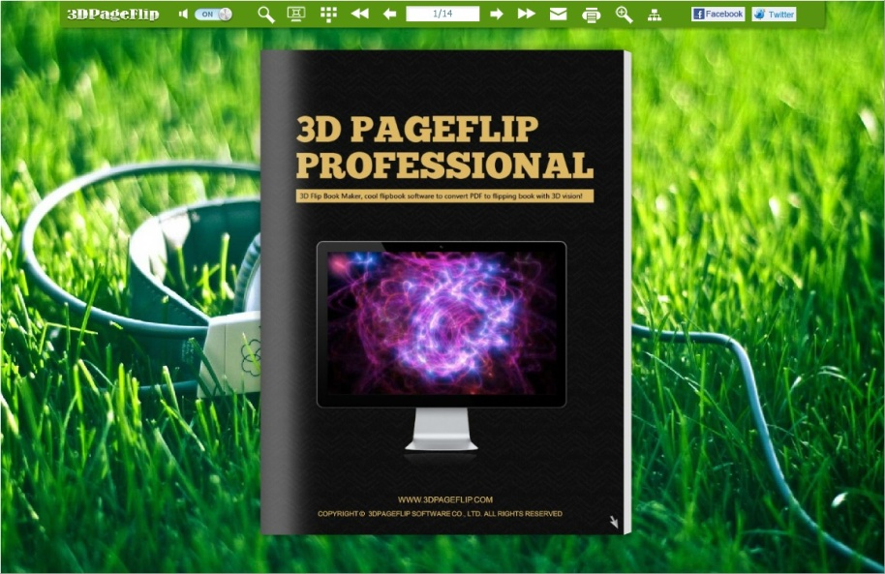
Step 3: template design settings
Third, you can adjust the tool bar color. What’s more, you can also modify the color and font of the buttons.

Slide 7


THANK YOU!
More information, please view this website: www.3dpageflip.com

