Slide 1
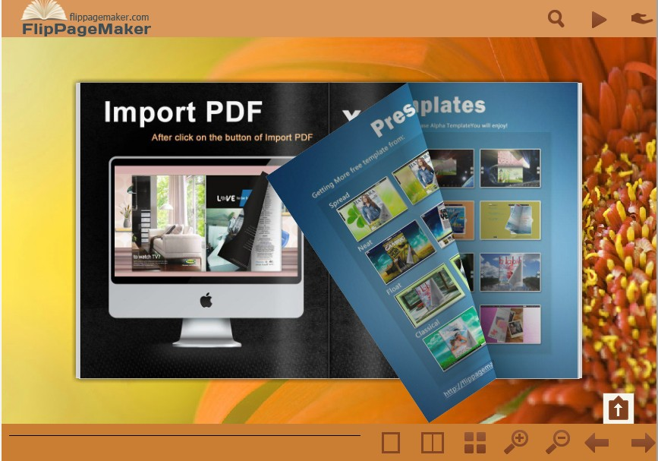
Create Colorful Bookmark Tabs With FlipBook Creator
Flippagemaker had announced a latest FlipBook Creator V3.8.8
For more information: http://flippagemaker.com/

Slide 2

Why Bookmark Tab is necessary?
FlipBook Creator is used to create flipping book from PDF file. Users can publish e-magazine, brochure, manual and catalog online. Recently, flippagemaker.com had announced new features in FlipBook Creator 3.8.8.
Add bookmark tab plays an important role for navigation. The feature allows users to set caption and page index for each bookmark tab easily. Go ahead to learn the simple steps to design colorful bookmark tab now!
For more information: http://flippagemaker.com/

Slide 3

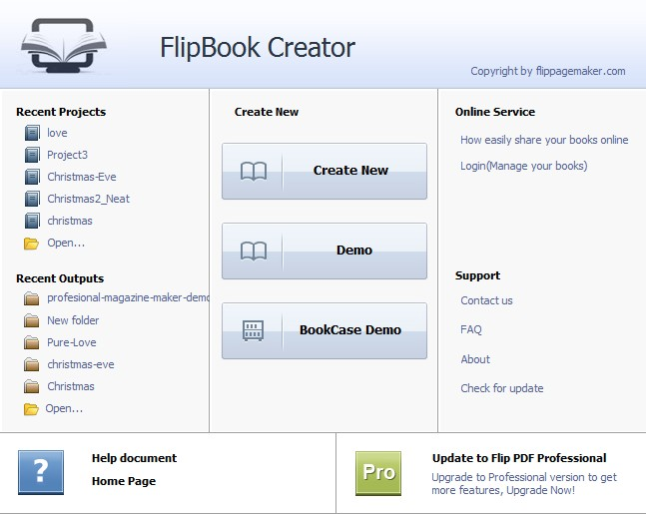
Step1, launch FlipBook Creator, click “Demo” to open the interface
For more information: http://flippagemaker.com/

Slide 4
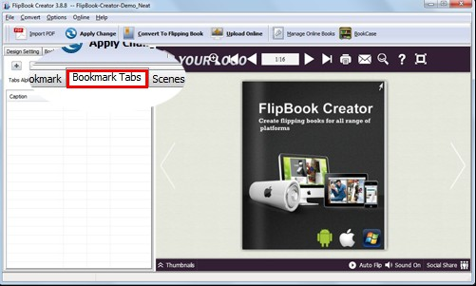
Step2, click “Bookmark Tabs” in the left panel
For more information: http://flippagemaker.com/

Slide 5

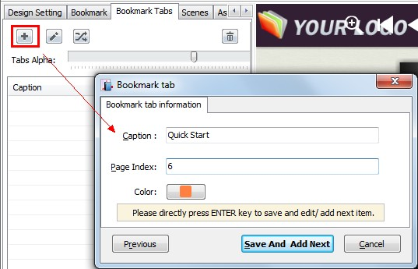
Step3, add bookmark tabs
For more information: http://flippagemaker.com/

Slide 6
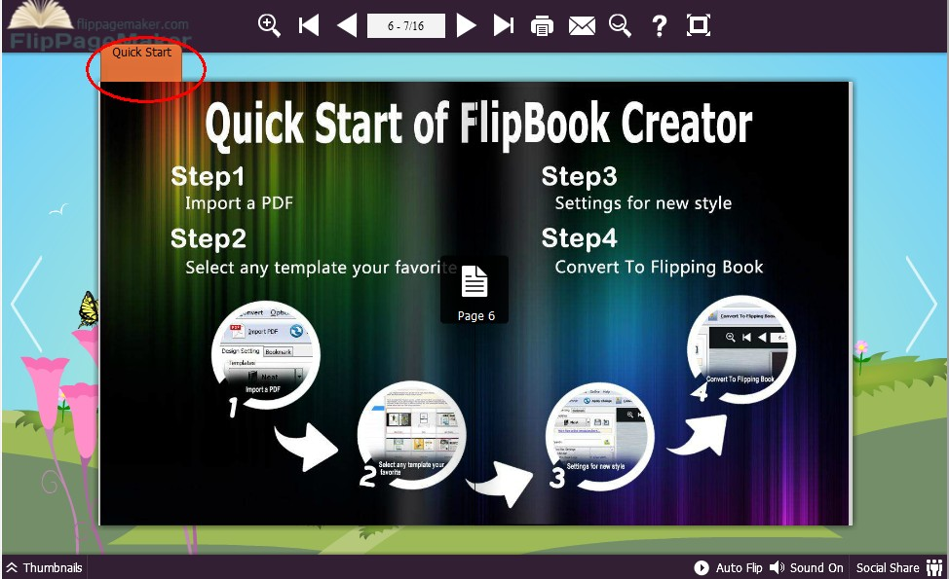
Step4, Apply Change to save the setting
For more information: http://flippagemaker.com/

Slide 7

Other excellent features of FlipBook Creator 3.8.8:
Upload Online Service ---- upload the created flipping book onto our service directly without output
Assistant ---- virtual character helps to speak the story in your flipping book
Bookcase ---- all flipping book in our service can be display in a bookcase
Learn more about flippagemaker.com

