Slide 1

Context Analytics, Inc.
Formerly Social Market Analytics
The Leader In Unstructured Data for Finance
ContextAnalytics-AI.com
ContactUs@ContextAnalytics-AI.com

Slide 2
CA Technology
CA NLP for Sentiment
CAs Patented Natural Language Processing was developed internally. We use a multi-pass phrase evaluation approach combining techniques like stemming and lemmatization. We apply both supervised and unsupervised machine learning on a ten-year training set.
Complex Topic Modeling
Topic Model Engine that utilizes collocation of rules to identify inclusions and exclusions in topic models. CA’s NLP uses Synonym identification to capture similar phrases to include in topic models. CA also identifies what the conversation is about and classifies news stories into dozens of categories.
CA Parsing Engine
CA’s parsing engine can convert any document to machine readable JSON in seconds. The JSON file is instantly suitable for storage, programmatic analysis and Natural Language Processing.
LLMs
Our processing, filtering, and classification of data makes it suitable to ingest into LLMS. Filing summarization, dynamic questioning of filings, filing themes…. Summary of sentiment on social feeds

Slide 3
CA Patented Process – Unstructured Alternative and Traditional Data
X
CA Patented Technology
StockTwits
Reddit
News
Global Filings
CA Metrics
Call Transcripts
Extractor
Evaluator
Calculator
Edgar Filings
Captures data
Structures content for further analysis with in-house NLP & Topic Modeling
Calculates custom metrics and publishes through JSON API
Up to 20+ Years
Of Data
ESG Reports
Custom Inputs
CA has 3 U.S. Patents behind our process

Slide 4
U.S. and Global Machine-Readable Filings
Context Analytics, Inc. in April 2020 released U.S. Machine Readable Filings (MRF) in partnership with S&P Global Market Intelligence. Machine Readable Filings is the first product to provide parsed textual data of SEC Edgar Regulatory Filings at the Item, Section, Sub-section, and Notes level with historical baselines back to 2006.
Context Analytics, Inc. in April 2021 released Global Machine Readable Filings (GMRF) in partnership with S&P Global Market Intelligence. Global Machine-Readable Filings is the first product to provide parsed textual data of international companies Annual, Quarterly, Semi-Annual Reports and Financial Supplements across ~2M documents spanning over 200 countries. These magazine-style documents are parsed according to the structure of the document itself with machine-readable text organized in multi-level JSON format.
4

Slide 5
EDGAR MRF Document Type and Count: 2006 – Feb. 2024
Main Types | Sub-Types | Total Count | Family Definition
10-K | 10-K/A, 10-K405, 10-K405/A, 10-KT, 10-KT/A | 176,711 | Form 10-K provides an annual comprehensive overview of the company's business and financial condition and includes audited financial statements
10-Q | 10-Q/A, 10-QT, 10-QT/A | 436,802 | Form 10-Q includes unaudited financial statements and provides a continuing view of the company's financial position during the year. The report must be filed for each of the first three fiscal quarters of the company's fiscal year
8-K | 8-K/A, 8-K12B, 8-K12B/A, 8-K12G3, 8-K12G3/A, 8-K15D5 | 1,506,551 | Form 8-K is the “current report” companies must file with the SEC to announce major events that shareholders should know about
20-F | 20-F/A | 17,544 | Form 20-F is an annual submitted by all "foreign private issuers" with listed equity share on exchanges in the U.S.
6-K | 6-K/A | 414,560 | Form 6-K is submitted by foreign private issuers of securities. Considered a catchall for material info between annual and quarterly reports and often include duplicate copies of the foreign private issuer’s latest financial reports, such as income statements, balance sheets and cash flow statements.
40-F | 40-F/A | 3,022 | Form 40-F is submitted by companies domiciled in Canada with securities registered in the U.S. It is an annual filing similar to Form 10-K for U.S.-based companies in purpose and content
S-1 | S-1/A | 60,933 | Form S-1 (often referred to as the “Registration Form”) is the company’s initial registration with the SEC, typically before the IPO. For U.S.-based companies only.
Total |  | 2,616,123

Slide 6
Global MRF Document Type and Count: 2006 – Feb. 2024
File Type | Filing Alias | English | File Type Definition
AR | Annual Report | 540,648 | Annual Report (Glossy): Optional filing at the SEC.
ARS | Annual Report | 1,654 | Annual Report to Shareholders.
ARS/A | Annual Report | 11 | Annual report to shareholders, amendment.
FIN SUPP | Financial Supplement | 851,069 | Financial Supplement to QR or AR: Packets of additional financial information to shareholders or analysts expanding on the annual or quarterly report.
Intierra SR | Interim Report | 4,201 | Semi-Annual or Interim Report (Metals/Mining related)
MEG - AR | Annual Report | 6,491 | Annual Report to Shareholders (Metals/Mining-related)
Other Financials | Misc | 685,269 | Financial information containing Documents that have not been categorized to an existing FileType.
QR | Quarterly Report | 167,326 | Quarterly Report (Glossy): Earnings-related release to shareholders published on a quarterly basis. Provides abbreviated financial statements.
QR/A | Quarterly Report | 12 | Amendment to Quarterly Report (Glossy): Earnings-related release to shareholders published on a quarterly basis. Provides abbreviated financial statements.
SR | Interim Report | 88,281 | Semi-Annual or Interim Report: earnings related report providing financial information for a six-month period of time issued by non-U.S. companies.
Tanshin | Quarterly Report | 18,914 | Earnings Release by Japanese companies available on the Tokyo Stock Exchange or company website
Total Docs |  | 2,363,876

Slide 7
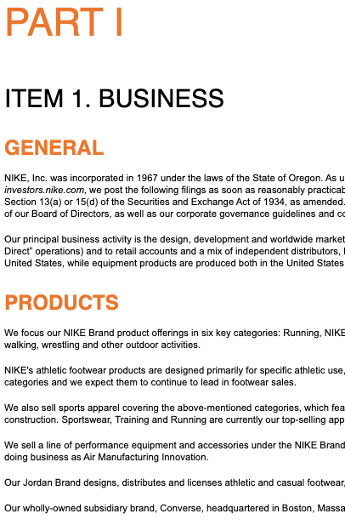
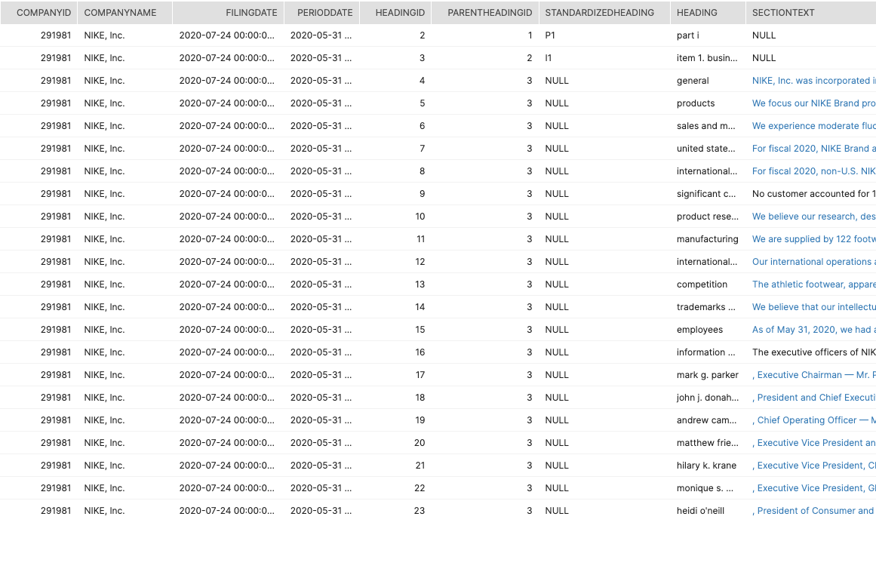
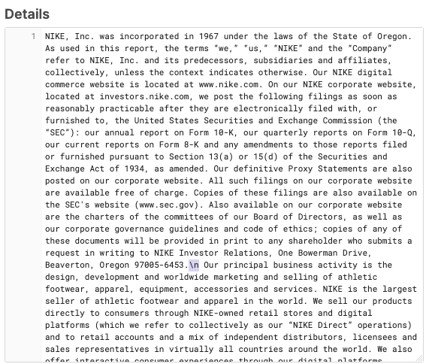
MRF - 10-K Parsing
The header level parsing allows for a fine grain comparison of document changes through the years. For example, if there is a change in the “Products” header, it is likely that there is a change in product offerings instead of just knowing there is a change in “Item 1”
Part and Item are standardized in MRF
Each sub-section in Edgar is parsed as a separate heading in MRF
All sub-sections and their text within I1 will have a parent ID of 3 because that is the heading ID of I1
Each paragraph from Edgar is parsed contains a new-line break in MRF and is placed under its respective header
Section Text under ’General’ expanded
Edgar Item 1 MRF Item 1
7

Slide 8
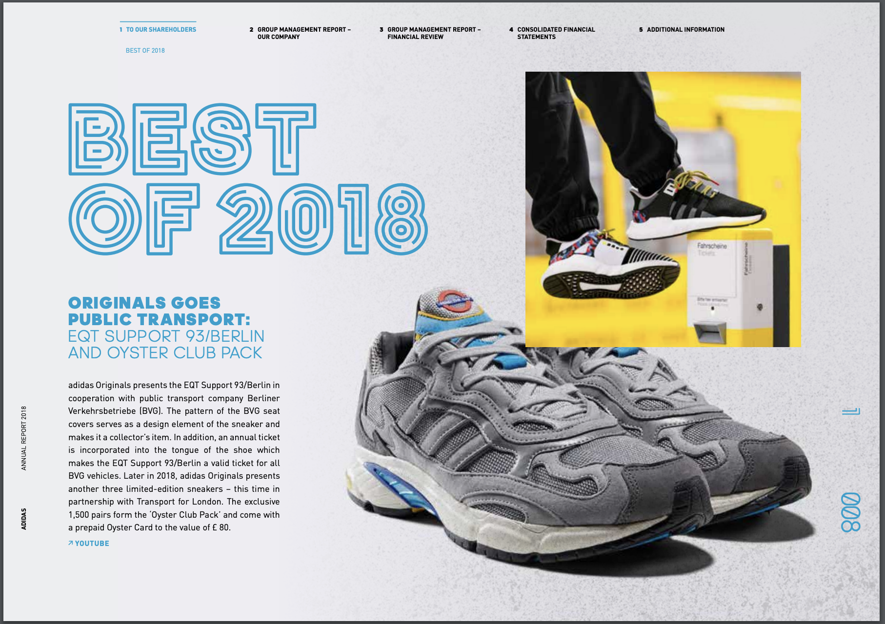
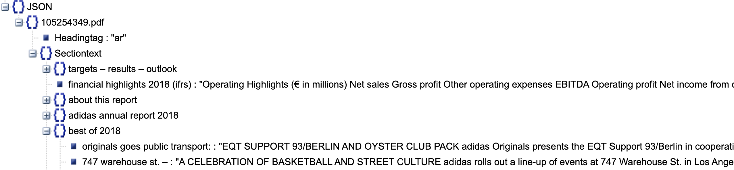
GMRF – Annual Report Parsing
Ignores Text
GMRF takes complicated, magazine-style documents and parses them into machine readable multi-level JSON for seamless integration into alternative data NLP models
Use this multi-level JSON to track changes in a company’s operations, gain insight on new products, and integrate international risk factors into models
Ignore Text
8

Slide 9
CompuText: Collaboration with Academics
Joshua Livnat, CPA (inactive), PhD in Accounting, Professor Emeritus of Accounting at New York University, and former Head of Research at Quantitative Management Associates LLC.
Kate Suslava, CPA, CFA, MA in Linguistics & PhD in Accounting, Associate Professor of Accounting at Bucknell University

Slide 10
Livnat and Suslava Publications on NLP
Sentiment is reflected in subsequent abnormal returns
The Journal of Financial Data Science: A Practical Approach to Advanced Text Mining in Finance.
NLP signal for financial metrics has predictive value
The Journal of Portfolio Management: Margin Forecasts by Managers and Analysts.
Firms disclosures on current events predict stock movement
The Journal of Investing: Fake Tariff News: Is Corporate America Concerned with Trade Wars?
Stock market reacts to verbal behavior of firm executives on the calls
Journal of Accounting and Public Policy: Gender difference in CFO communication: Evidence from earnings calls.
The Journal of Financial Data Science: When More or Less is Less: Managers’ Clichés.
Management Science: “Stiff business headwinds and unchartered economic waters”: Use of Euphemisms in Earnings Conference Calls
The Journal of Financial Reporting: Order Backlog in Earnings Conference Calls.
The Journal of Accounting and Public Policy: Market Reaction to Quantitative and Qualitative Order Backlog Disclosures.

Slide 11
CompuText: Reading into Financial Results
NLP Rules
Supervised machine learning focused on financial statement items: Sales, Inventory, Debt
Extraction
Rule applied to the full repository of MRF, GMRF, and Earning Call documents
Output
Company and document IDs
Curated list of voluntary disclosures with predictive power: Order Backlog, Liquidity, Going Concern
Classify sentences by Parent Topic (Inventory), Subtopic (Inventory Increase), Reasons (Higher Demand).
Assign Polarity (Positive, Negative, Neutral) to Subtopic and Reason
Document section (i.e. Management Discussion vs. Q&A for Earnings Calls)
Parent Topic, Subtopic, Reason
Polarity
Extracted sentence

Slide 12
CompuText: Insights
Identification of Events* with Polarity
Ability to construct a sentiment score by weighting extractions and polarity
Use labeled sentences to train LLM model
*Events are defined as a change, shift or current description of a company’s financial values or metrics

Slide 13
CompuText: NLP Sentiment Behind Financials – Compustat 2.0
Income Statement
Balance Sheet
Sentence | Parent Topic | Sub-Topic | Polarity
Telus Corp, 4/10/24, AR: “In 2023, TELUS International (TI) realized solid revenue growth, as reported in our digitally-led customer experiences (DLCX) segment, driven by continued momentum from AI services.” | Sales | Sales Favorable | Positive
NEXGEL Inc, 4/10/24, 10-K: “The increase in cost of revenues pertains to an increase in materials and finished products and equipment, production, and other expenses..” | Cost of Goods Sold | Cost of Sales Increase | Negative
Canfor Corporation, 4/10/24, AR: “Year-to-date advertising and sales promotion expenses were up 21 percent to $13.7 million compared to the prior year fiscal period.” | SG&A | Advertising Expenses Increase | Negative
Durect Corp, 3/27/24, Earnings Call: “The decreases were primarily due to lower clinical trial-related expenses as we substantially completed the AHFIRM trial, lower contract manufacturing expenses and lower employee-related costs.” | Labor Cost | Labor Cost Decrease | Positive
Duerr AG, 3/27/24, AR: “Tax expense grew by 4.7 million, mainly because we increased tax provisions with regard to an ongoing tax audit.” | Tax Expense | Tax Expense Unfavorable | Negative
Sentence | Parent Topic | Sub-Topic | Polarity
Genel Energy Finance, 3/26/24, AR: “Genel retains a robust cash position, a resilient business model, and a focus on taking advantage of the material catalysts ahead.” | Cash | Cash Favorable | Positive
HF Foods Inc, 3/26/24, 10-K: “All other accounts receivable from these related parties are current and considered fully collectible.” | AR | AR Collections | Positive
Canfor Corporation, 4/10/24, AR: “As at December 31, 2023, Canfor, Vida and CPPI were fully in compliance with all covenants relating to their operating loan facilities.” | Debt | Debt Covenant | Positive
Statement of Cash Flows
Sentence | Parent Topic | Sub-Topic | Polarity
Petershill Partners PLC, 3/26/24, Earnings Call: “We delivered strong operating cash flows with a stable balance sheet, which has supported higher capital return in a slower year for M&A.” | Operating Cash Flows | Operating Cash Flows Favorable | Positive
Indorama Ventures, 3/22/24, AR: “The financial position has strengthened over the years with a larger equity base and increase in cash flow from operations.” | Operating Cash Flows | Operating Cash Flows Increase | Positive
CA Proprietary & Confidential

Slide 14
CompuText: Uncover Reasons Behind Financial Performance
Sentence | Parent Topic | Sub-Topic | Polarity | Reason | Reason Polarity
MaxLinear, 4/5/2024, AR: “The company's management lowered inventory levels due to reduced supply chain constraints and decreased customer demand for certain products.” | Inventory | Inventory Decrease | Positive | Low Demand | Negative
Unite Group PLC, 4/10/24, AR: “The war between Ukraine and Russia has not yet been resolved, affecting the prices of energy and main raw materials, causing production costs to increase.” | Cost of Goods Sold | Production Cost Increase | Negative | War | Negative
Primo Water Corporation, 3/29/24, AR: “Other SG&A expenses increased to $53.0 million in 2022 compared to $49.2 million in 2021, due primarily to inflationary labor cost increases, which increased by $4.9 million from 2021.” | Labor Cost | Labor Cost Increase | Negative | Inflation | Negative
Xos, Inc, 3/29/24, 10-K: “The increase in revenues for the year ended December 31, 2023, was driven by increased deliveries of our stepvans coupled with an increase in average selling price associated with sales of our updated stepvan platform produced and delivered in the current year. | Sales | Sales Increase | Positive | Pricing, Distribution | Positive
CA Proprietary & Confidential

Slide 15
CompuText: Go Above and Beyond Financial Statement Items
Sentence | Parent Topic | Sub-Topic | Polarity
Diamondhead Casino Corporation, 3/29/2024, 10-K: “The Company has incurred continued losses over the years and certain conditions raise substantial doubt about the Company's ability to continue as a going concern.” | Going Concern | Going Concern: Significant Doubt | Negative
Danimer Scientific, Inc., 3/29/24, 10-K: “We believe we have adequate liquidity to fund our operations for the next twelve months.” | Liquidity | Liquidity Favorable | Positive
Cambi ASA, 4/17/24, AR: “The order backlog provides good financial visibility into the coming years.” | Backlog | Backlog Favorable | Positive
Delta Air Lines, 4/10/24, Earnings Call: “And we still have a shortage of ATC controllers, so it 's still an incredibly challenging environment.” | Environment | Unfavorable Environment | Negative
Airbus, 4/10/24, Earnings Call: “The strong free cash flow generation, in particular, in the last quarter has brought our net cash above EUR 10 billion.” | Free Cash Flow | Favorable Free Cash Flow | Positive
CA Proprietary & Confidential

Slide 16
Computext vs. LLMs
Computext | Large Language Models
Gain insights from finance experts with PhD, CFA, and CPA credentials, ensuring top-tier event extraction and polarity analysis for investors. | Highly sensitive and complex prompting makes results unreliable and difficult to engineer.
Focus on critical financial event shifts to deliver targeted and actionable intelligence. | Requires extensive tuning as it is trained on general language, designed by tech experts for language comprehension and generation.
Leverage investor-centric analysis of specific events and topics to create precise sentiment and polarity assessments. | Reads the full text or hand-selected snippets to apply analysis, sentiment, or summarize key points
Customize weightings for different topics, providing point-in-time data ideal for unbiased backtesting. | Topics and weights are determined by what is found in the document (feature extraction). Subject to temporal look ahead bias
Enhance your Large Language Models with a proven roadmap for AI prompting, backed by expertly labeled data | Enhancements are limited to the data provided.
Skip development costs with our ready-to-use data, instantly adding value without the need for embedding or transforming | Incurs significant costs for development, QA teams, and AI licensing, with a 3-4 week period needed for embedding and transforming to potentially add value.
Notes:
Top down vs bottom up. “Let’s create events out of the most frequent words”. We tell it what to look for. We base this on approach to analyzing financial items. Framework from computstat and used by quants for ~50 years.
Large Language models can create any output.
Sensitive prompting. Same question different answer
Prompt inspiration
Road map to prompting
Summary won’t
Computext fragments text

Slide 17
Appendix
CA Proprietary & Confidential

Slide 18
Computext Example
Sentence: “For the first quarter of 2024, general and administrative expenses increased $4,013 to $88,778, due to increased payroll related expenses and purchased services when compared with the same quarter of 2023.”
2 Topics and Sub-Topics are captured from this sentence:
  Labor Cost - Increase
  Selling General Administrative - Increase
This sentence comes from a 10-Q released on April 22nd, 2024 by Electronic Systems Technology, Inc.
DocumentId corresponds to MRF/GMRF Reference DocumentId, which has all company information provided (CompanyId, Company Name, etc.)
Sentiment on the topic is provided. An increase in Labor Costs and SG&A are interpreted as negative sentiment
DocumentId | DocumentDate | DocumentType | CompanyId | Ticker | CompanyName | Heading | GStatKey | Parent Topic | Sub-Topic | Term Polarity | Reason | Reason Polarity | SentenceID
221816772 | 4/22/24 | 10-Q | 268898 | ELST | Electronic Systems Technology, Inc. | main.p1.i2.l4 | XSTFWS | Labor Cost | Labor Cost Increase | Negative | Staffing | Neutral | YQvsBY8BBY2Z6pZ9D57_
221816772 | 4/22/24 | 10-Q | 268898 | ELST | Electronic Systems Technology, Inc. | main.p1.i2.l4 | XSGA | Selling General Administrative | Selling General Administrative Increase | Negative |  |  | YQvsBY8BBY2Z6pZ9D57_
CA Proprietary & Confidential

Slide 19
CompuText: Product Description
Using the repository of MRF and GMRF documents, CompuText extracts sentences from documents containing items related to Income Statements, Balance Sheets, and Cash Flow Statements
  20+ Items currently in production (Sales, Inventory, Cost of Goods Sold, Margins, Accounts Payable, etc.)
  Includes all major document types (10-K, 10-Q, 8-K, 6-K, 20-F, 40-F, AR, QR, Earning Calls, etc.)
Provides users quick way of identifying key sentences pertaining to items as well as the location of sentences within the document
Concise summary of sentences driving the company financially
Items are tagged as positive/neutral/negative based on sentiment of phases within the Sentence extracted
CA Proprietary & Confidential

Slide 20
CompuText: Field Descriptions
Column Name | Description
DocumentId | Unique identifier of the document filing
DocumentDate | Date the filing became available to the public
Period Date | Date on which an event occurred requiring a filing
Date Processed | The date and time of the latest modification to the parsing of the filing
DocumentType | Type of filing (10-K, 10-Q, AR, QR, etc.)
CompanyId | The S&P Capital IQ unique entity identifier
Ticker | Symbol linked to the CompanyId
CompanyName | Name of the company
Heading | Document section that a Sentence is extracted from
Compustat_Code | Compustat_Item_Code
Parent Topic | Data item name
Sub-Topic | Categorization of Parent Topic based on the descriptions of results/actions around the Parent Topic.
Term Polarity | Sentiment of topic being extracted (Positive, Neutral, or Negative)
Reason | Subject identified as the impact of Sub-Topic
Reason Polarity | Sentiment of reason being extracted (Positive, Neutral, or Negative)
SentenceID | Unique identifier of sentence within each document
Sentence | Text extracted around the identified topic
CA Proprietary & Confidential

Slide 21
CompuText: List of Parent Topics
Compustat_Code | Parent Topic
AP | Accounts Payable
ARC | Accounts Receivable
OB | Backlog
CAPX | Capital Expenditures
CH | Cash
CLT | Contingent Liability
COGS | Cost of Goods Sold
DLTT | Debt
 | Environment
 | Free Cash Flow
 | Going Concern
INTAN | Intangibles
Compustat_Code | Parent Topic
INVT | Inventory
XSTFWS | Labor Cost
 | Liquidity
GP | Margin
MIB | Minority Interest
OANCF | Operating Cash Flow
PPENT | PPE
XRENT | Rent Expense
SALE | Sales
XSGA | Selling General Administrative
TXT | Tax Expense
This list is subject to expand intended to cover all compustat items
CA Proprietary & Confidential

Slide 22
Bibliography
  Klevak, J., J. Livnat, & K. Suslava. A Practical Approach to Advanced Text Mining in Finance. The Journal of Financial Data Science, Winter 2019, 1 (1), 122-129.
  Klevak, J., J. Livnat, D. Pei, & K. Suslava. Fake Tariff News: Is Corporate America Concerned with Trade Wars? The Journal of Investing, August 2019, 28 (5) 122-131.
  Klevak, J., J. Livnat, & K. Suslava. 2019. When More or Less is Less: Managers’ Clichés. The Journal of Financial Data Science, Summer 2019, 1 (3), 57-67.
  Suslava, K. “Stiff business headwinds and unchartered economic waters”: Use of Euphemisms in Earnings Conference Calls, Management Science, January 2021, 67 (1) 6629-7289.
  Feldman, R., S. Govindaraj, J. Livnat & K. Suslava. Market Reaction to Quantitative and Qualitative Order Backlog Disclosures. The Journal of Accounting and Public Policy, October-November 2021, 40 (6).
  Feldman, R., S. Govindaraj, J. Livnat & K. Suslava. Order Backlog in Earnings Conference Calls. The Journal of Financial Reporting, September 2022, 7 (2): 83-104.
  Levi, S., J. Livnat, & K. Suslava. Margin Forecasts by Managers and Analysts. April 2023. The Journal of Portfolio Management.
  Klevak J., Livnat J., & K. Suslava. Gender difference in CFO communication: Evidence from earnings calls. Journal of Accounting and Public Policy, Volume 44, 2024.
CA Proprietary & Confidential

