Slide 1

Dance It Out
Media Kit

Slide 2
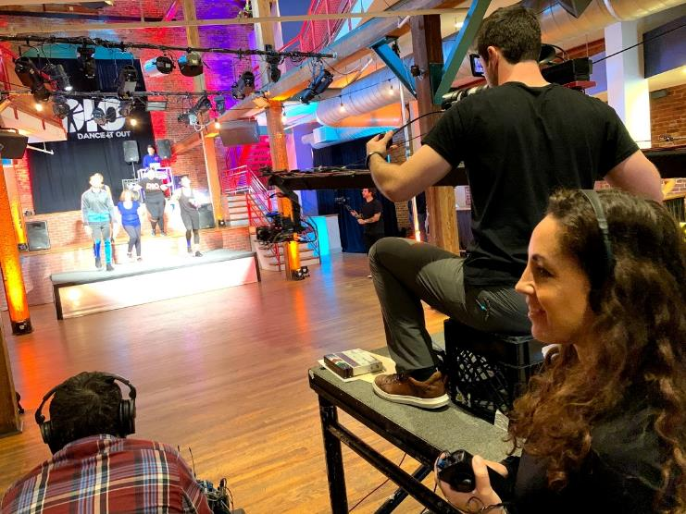
Contents
Show Overview
Audience
Talent
Promotional Plan
Sponsorship Opportunities

Slide 3
Health and Fitness are booming
Growth across the board:
Wearables
Healthy Foods
Insurance Costs
“Currently about 20% of American adults have a fitness club membership, a number that in my opinion could easily double in the next 10 – 15 years.” - Forbes
Gym Memberships
Streaming Exercise Classes
Fitness Apps
The world is looking for a better way to get fit while being inspired…

Slide 4
Imagine…
Tapping into the current golden age of television by delivering an innovative new program that combines getting fit while being inspired…
Making an Audience Feel Good Both Inside and Out!

Slide 5
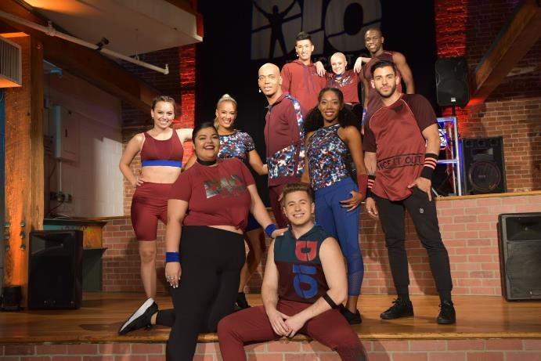
Introducing Dance It Out
“Dance it Out”, with International Fitness Celebrity Billy Blanks Jr., is the first ever of its kind, Dance Fitness Show featuring inspirational guests and celebrities.
DIO is a 30-minute 10-episode television series airing on the Lifetime Network, (a global Disney subsidiary with over 80 million viewers), Saturdays 10:30am EST/USA premiering February 15, 2020.
www.danceitout.com
https://www.youtube.com/watch?v=qALp_kg53ys&list=PL5QlpyUa7vAVDkRNi3PRxWRtac9Frs3qb

Slide 6
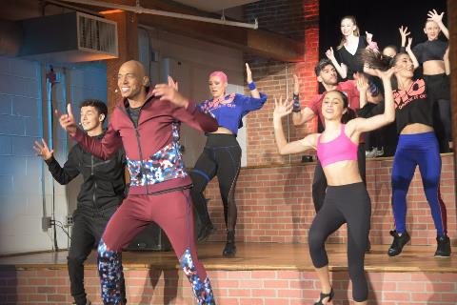
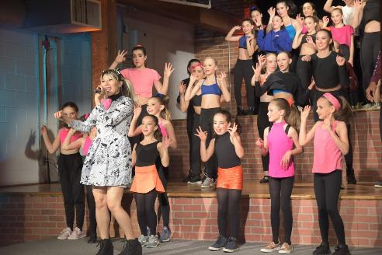
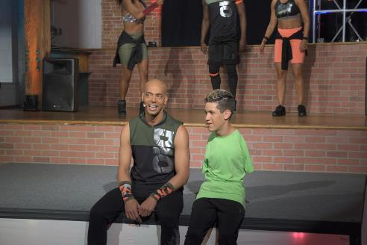
DIO Show Brief
Designed to get people up and moving, Dance It Out is a fun-filled inspiring program complete with weekly “every man/woman/child” guests. Through a mix of dance and emotional interviews, they share their soul affirming stories of overcoming major medical, life, loss and emotional events through movement.
In addition to Billy, these key contributors are also inspired and supported by a celebrity guest-stars from music, TV, theatre and/or social media. While providing the famed Dance It Out fitness workout, the DIO message is always on point letting viewers know they are not alone in their struggles and there is always a way to keep moving to get the best out of life.
Billy guides the audience through his proprietary workout program with a dazzling cast of DIO Pro Back Up Dancers and an energized VJ/MC who spins originally composed DIO music. The dynamic and emotionally engaging tracks range from Pop, Hip Hop, Broadway, Salsa, Bollywood, Jazz, Reggae and more!

Slide 7

Target Audience
Primary: Lifetime’s target audience is 75% females with ages 50+ representing 51% of the audience.
Secondary: Equally split are ages 18-34 (25%) and ages 35-49 (25%)
It is a multigenerational audience (Teens, Adults and Seniors/Grandparents)
Additional Demographics:
  65% of Lifetime viewers own a home
  HHI: 24% - $25K-$49K, 33% - $50K+
  38% - 1+ Child in HH
Psychographic profile: Lifetime offers its viewers modern, sexy, daring and provocative programming.
Other Lifetime programs include Dance Moms, Project Runway, Bring It!, Surviving R. Kelly, UnReal, etc.
Dance Moms pulled in 2.8 million viewers and 1.4 million adults ages 18-49 in a similar timeslot on Lifetime (3rd season).

Slide 8
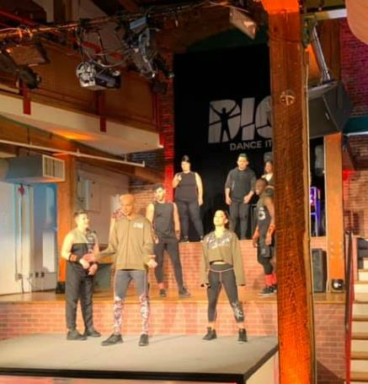
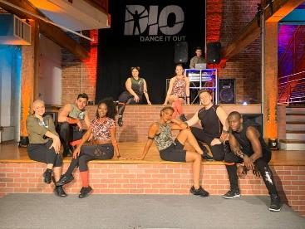
Show Talent
Host: Billy Blanks, Jr.
  Professional dancer, director, producer.
  Entertainment credits include: music videos with Paula Abdul, Madonna, Celine Dion, Crystal Method (directed by Gore Verbinski), Quincy Jones, and Babyface. TV appearances on American Dreams with Alicia Keys, The Practice, Sister Sister, Kids Incorporated, Homeboys From Outer Space, My Cousin Skeeter, and The Tonight Show. Directed One Night With The Stars starring Broadway Legends Betty Buckley, Lainie Kazan, Telly Leung, Tom Bergeron, Jordin Sparks, Fran Drescher, and many more
DIO Pro Back Up Dancers: include Payton Ackerman from, “Dance Moms” and Jeimy Bueno, Zumba Celebrity.
One special team from Season 1, Dr. Mike and Andrew of MoveU were the invited Guest Fitness Experts featured at the 2019 MeFitPro Fitness Institute in Dubai.
See appendix for full guest lineup for season 1

Slide 9



Promotional Plan
Lifetime Network bumpers and TV Guide Listing
Social Media ads targeting BBJ/DIO followers/fans of 2M+
Social Media postings by guests and celebrities with combined followers of 2,000,000+
PR Campaign including TV and radio interviews, press releases, websites and postings by DIO team, guests and celebrities.
Future re-airing and repackaging to sell on other networks, streaming vehicles and in international markets.

Slide 10
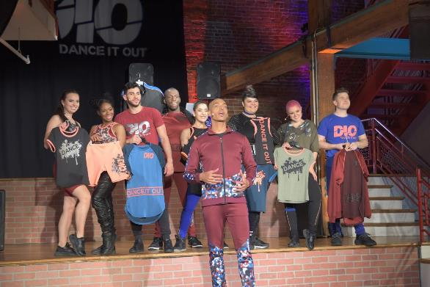
Sponsorship Opportunities
Limited Opportunities Available:
15/30 Second Spots
  Extremely light ad load, high share of voice
  Ad Slots will appear at top, during water breaks and at end of show
Integrated packages branded with DIO and Lifetime
  Organic mentions of brand
  Brand Content Advertising for Sponsor Site
  Sponsor Mention in all PR Materials
  Sponsor Appearance on Network, App and Sites
Custom sponsorship packages also available
Contact Liza Rivera Salta Tel: 203-952-9769 Email: lizasalta@gmail.com

Slide 11
Appendix
Season 1 Guest Lineup
Social media stats
Producer Credits

Slide 12
Season 1 Guest Line-Up
Payton Ackerman, Pro Back Up Dancer (Dance Moms)
Jeimy Bueno, Pro Back Up Dancer (Zumba Celebrity)
Timothy Bannon (YouTube Influencer with 112M+ views)
FitThomas (Fitness Influencer 3K fans)
MoveU (Fitness Experts 1M+ fans)
Bryson Bernard (Artist/Creator of The Cupid Shuffle Dance)
Chesney Snow (Broadway Star)
Mystic Bowie’s Talking Dreads (Reggae Music Star)
James Iglehart (Tony Award-winning Broadway Star: Aladdin’s Genie & Hamilton)
Aydin Eyikan (World of Dance)
Reni Mimura (Japanese Pop Star)
Original DIO Theme & Music by Tom Salta (ASCAP Winning & MTV VMA nominated composer)

Slide 13
Social Media Stats
 | Instagram | FB | YouTube
Billy Blanks JR | 11,800 | 2,255 | 896,000
MOVETUBE BBJ | 941 | 1,000 | 168,000
DIO Brand |  | 10,000 | 1,000,000
Jeimy Bueno (Zumba) | 34,800 | 2,200 | 1,000
Payton Ackerman | 614,000 | 3,200 | 43,100
Fit Thomas (Austin) | 285,000
Chesney Snow | 2,102 | 489 | 3,000
Timothy Bannon |  |  | 112,000,000
Mystic Bowie/Talk Dreads | 5,012 | 10,000 | 25,000
James Inglehart |  | 11,000 | 1,000,000
MoveU | 1,000,000 | 57,000 | 29,300
Dr Mike Wasilisin | 25,900
Andrew Dettelbach | 84,700
Aydin Eyikan | 26,300 | 338 | 8,000
Cupid (Bryson Bernard) | 50,000 | 46,000 | 68,000,000
Reni Mimura | 1,887 | 20,000 | 1,800,000
TOTALS | 2,142,442 | 163,482 | 180,973,400

Slide 14
Billy Blanks, Jr. - Host
Billy Blanks Jr - Self-taught working professionally from his youth, Billy Blanks Jr. gained much exposure and experience in the world of dance and entertainment. As a young teen he choreographed school musical productions and created after school dance groups. As Billy’s prominence grew, he earned roles as a dancer in music videos with Paula Abdul, Madonna, Celine Dion, Crystal Method (directed by Gore Verbinski), Quincy Jones, and Babyface. His credits include TV appearances on American Dreams with Alicia Keys, The Practice, Sister Sister, Kids Incorporated, Homeboys From Outer Space, My Cousin Skeeter, and The Tonight Show. Billy starred as Tyrone Jackson in the US and European touring companies of the Broadway musical Fame. He went on to direct and choreograph the WeSparkle Take II Celebrity Concert with Tom Hanks, Jason Alexander, Brian Cranston, Joey Lawrence, Britney Spears, Michael Chiklis, Hal Sparks, the cast of Will & Grace, and more. He also choreographed the end sequence for the movie I Hope You Dance. Billy made his directorial debut in NYC at Madison Square Garden directing One Night With The Stars starring Broadway Legends Betty Buckley, Lainie Kazan, Telly Leung, Mandy Gonzalez, Constantine, Tom Bergeron, Jordin Sparks, Noah Galvin, Fran
Drescher, and many more.
Over time, Billy has become the face for the new generation of fitness with his revolutionary dance program, Dance It Out. He made history on the hit TV show Shark Tank after turning down a deal proposed by Mark Cuban and Daymond John when the latter shark left the tank and talked Billy into taking the deal. The result was his business Dance It Out® (DIO®) becoming the fastest growing fitness based dance program in America. Billy is the son of Tae Bo® creator Billy Blanks.
In October 2015, Billy Blanks Jr. launched the MoveTube Network where he produces and directs feel good workouts, motivational content, and other inspirational videos featuring today’s hottest dancers and celebrities. Billy Blanks Jr. ACE certified, is a member of EQUITY, SAG-AFTRA and is the proud dad to son Elijah.

Slide 15
Chris Perera - PRoducer
Chris Perera is an award-winning executive producer, show runner and producer who's worked across many of television's premier networks including A&E, ABC, CBS, Discovery, TLC, Discovery Health, HGTV, DIY, Fine Living, Style, National Geographic and TV-One. Credits include showrunner for Nat Geo’s critically acclaimed “American Weed”, TV One’s “Celebrity Crime Files”.
Perera was a supervising producer for ABC’s award-winning, “NY Med” as well as producing and directing work for a number of hit shows that include “Say Yes to the Dress”, “Tiny House Nation” and "While You Were Out." As the head of development for Leopard Films USA, Perera played the key role in creating, packaging and selling series, specials and pilots that include “House Hunters International” for HGTV, “Man Caves” for DIY, “Doctors on the Edge” for A&E, “Ugly Agency” for TLC, “Dear Genevieve” for HGTV and “Matchmaker” for HGTV.
In addition to creating, executive producing and supervising programs, Perera is a director, director of photography and video journalist. He spent his 20's working as a TV news reporter and anchorman.

Slide 16
Ric Zivic - Producer
Ric Zivic is an Emmy award winning, Tony and Grammy nominated producer and composer who works across all forms of media including television, film, stage, advertising and music. Ric’s relationships with networks, syndicators and advertisers has enabled him to develop TV and Film programming that features branding, sponsor integration and sales strategies. His packaging includes project development for both scripted and non-scripted projects, time buys, talent acquisition, creative development and financing.
Ric is a three time Tony nominee as producer for the Broadway hit, "A Christmas Story, The Musical." He was also the executive producer for the critically acclaimed holiday film, “The Christmas Secret,” starring Beau Bridges and Richard Thomas, the highest rated film on CBS for the year it premiered, and continues as a beloved Christmas classic. It can be seen every holiday season on networks that include ABC Family, Hallmark and TMC. Ric has also executive produced other feature films that include “Civil Unrest,” “The Garden,” and “Zoo.” He is currently Executive Producer on the CGI feature film “The Christmas That Almost Wasn’t,” based on the classic Ogden Nash book. Ric was Executive in charge of Production, Post and Music for the Hit TV Series “Overhaulin”, which airs on Discovery and Velocity and Produced the global Eco-Documentary “Winds of Change”. He also Produced the popular series of TV specials “UFO’s and Aliens: The Search For the Truth,” and “The Human Canvas,” for TLC and the Discovery Network.
As an award winning music producer and musician, Ric landed a major record deal on Polydor Records in the ‘80s as the lead singer for the group, 3-D, and with producer Ken Scott (David Bowie, Supertramp), proceeded to write, co-produce and record two critically acclaimed albums and videos, launching the cult classic hit songs “X-Ray Eyes” and “All Night Television.” Ric and 3-D toured the country with major groups, such as The Cars, The J. Geils Band, Eddie Money and The Ramones. Ric also appeared on MTV’s Video Countdown, along with live performances on Saturday Night Live with musical co-host Paul McCartney.

Slide 17
Tom Salta – Producer and Music Composer
Tom Salta ASCAP winning, TEDx Presenter and MTV VMA nominated composer Tom Salta is one of the most versatile and prolific music artists/producers working in film, television, advertising and video games. Renowned for crafting emotionally engaging soundtracks for multimedia, Salta has received widespread industry acclaim for his world-class produced hybrid scores featured in film, television and video games such as Machine Games’ WOLFENSTEIN : Youngblood & Cyberpilot, Microsoft’s iconic HALO series (G.A.N.G. Best Original Soundtrack Award), Ubisoft’s PRINCE OF PERSIA: The Forgotten Sands and RED STEEL (IGN Award for Best Original Score), Tom Clancy’s GHOST RECON and H.A.W.X series, as well as the epic theme music for the record-breaking online multiplayer game PLAYERUNKNOWN’s BATTLEGROUNDS, which has sold in excess of 50 million units with over 400 million players.
Prior to his composing career, Salta toured with and worked on releases by a diverse array of popular recording artists. After several years of touring, Salta became increasingly immersed in studio work, producing, remixing and songwriting. Recording under the artist name “Atlas Plug,” Salta released the critically acclaimed electronic / orchestral music album “2 Days or Die” which quickly caught the attention of leading music supervisors. His album introduced a new hybrid sound to the visual entertainment industry at large, garnering high-profile placements on numerous television shows, international commercials and movie trailers, simultaneously launching his music career in video games, which he continues to embrace as a cutting-edge and powerful musical voice in modern scoring.

