Slide 1



The Global Clearinghouse for
B2B Hotel Bookings
PRIVATE & CONFIDENTIAL

Slide 2


15.5 million rooms.
750,000+ properties.
$330 billion in annual B2B transactions.
Highly fragmented and ripe for disruption.
The Opportunity
Up to 40% of hotel margin is taken when bookings go through wholesalers and other middlemen.

Slide 3








The Global Clearinghouse for Hotel Bookings Between B2B Buyers and Suppliers
Transaction Processing Service • One Contract • Standardized settlement • Currency conversion
THE SOLUTION
BENEFITS TO TOUR OPERATORS, TRAVEL AGENTS, AND OTAs:
POWERFUL TWO-SIDED
NETWORK EFFECTS
More transactions lead
to more inventory
and vice versa.
BENEFITS TO MAJOR CHAINS AND INDEPENDENT HOTELS:
Lower Transaction Costs
Direct Supplier Connection Better Margins
Lower transaction costs
Better visibility & control
Better margins.

Slide 4

3.5%
Transaction fee
THE MODEL
2%
Currency arbitrage
$40
Average revenue per transaction
83%
Contribution margin
+
=
@

Slide 5
Where we’re headed…
ROLLOUT AND PROJECTIONS
YEAR THREE- 2024
$400M in bookings
$20M in revenue
DEC 2023
$10M annual revenue run rate
June 2023
Achieve proﬁtability $3M annual revenue run rate
Oct 2022
Product V2 Soft Market Entry
TODAY
250,000 hotels on platform, signed contracts w/ trade buyers making millions of bookings per year.
UK PILOT -
COMPLETED
1500 transactions per month.

Slide 6

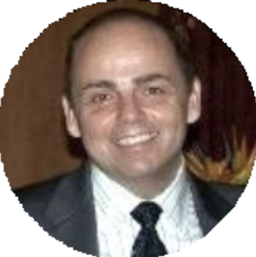

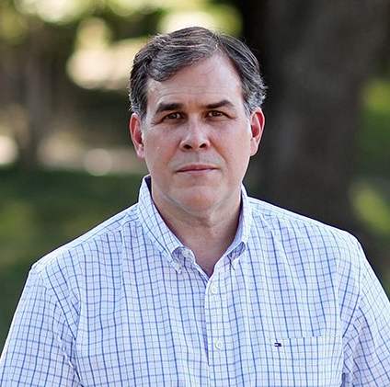
This experienced team will make it all happen…
THE TEAM
BILL GUERIN
CEO
Serial technology entrepreneur with signiﬁcant travel and hotel industry experience. Sold Marathon Systems, an INC 500 technology company, to Lotus Development Corporation.
DAN MOORE
FINANCE
Senior ﬁnance executive in hotel industry as Corporate Controller, Director of Finance and Director of Internal Audit with hotel industry companies such as Ritz-Carlton and Sage Management.
DAVE KUHN
MARKETING
Senior Travel Operations Executive in Product Development, Marketing, and Project Management. 25+ years experience in both Corporate and Start-Up Travel Technology Environments.
BRAD SCHNEIDER TECHNOLOGY
Proven track record in large scale Internet eCommerce projects. Hands-on experience as a director, architect, tech lead, project manager and ScrumMaster. Leadership on strategic technology direction with companies including Hotels.com/Expedia, Hilton and Sabre.

Slide 7
Raising $3.0 million to expand our technology platform for full launch in Q4 2022 with contracted customers and distribution technology partners, build out operations and scale revenue.
Visit : RoomRocket.Com
THE ASK

